Slide 1
We must honor the invaluable contributions and dedication of our long-standing members who built this organization.

Slide 2
We NEED new members aged 60-70

Slide 3
We NEED new members aged 60-70
WHY?

Slide 4
Change is ESSENTIAL!
Be Aware of Two Facts:
Our membership is declining at ~4%+/yr
Our average age is now around 80+
For SIR to Survive
We need to recruit more younger members (aged 60-70) to inject new energy and ensure the future of our branches by cultivating a stream of new leaders.

Slide 5
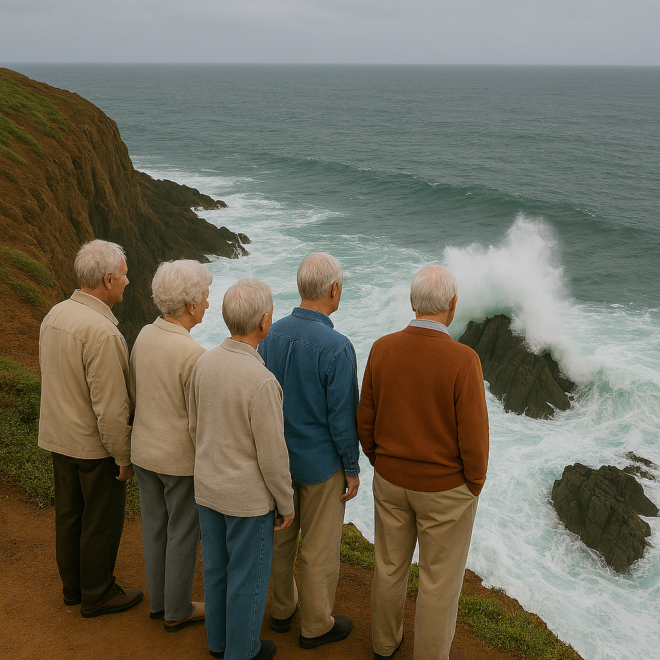

Slide 6
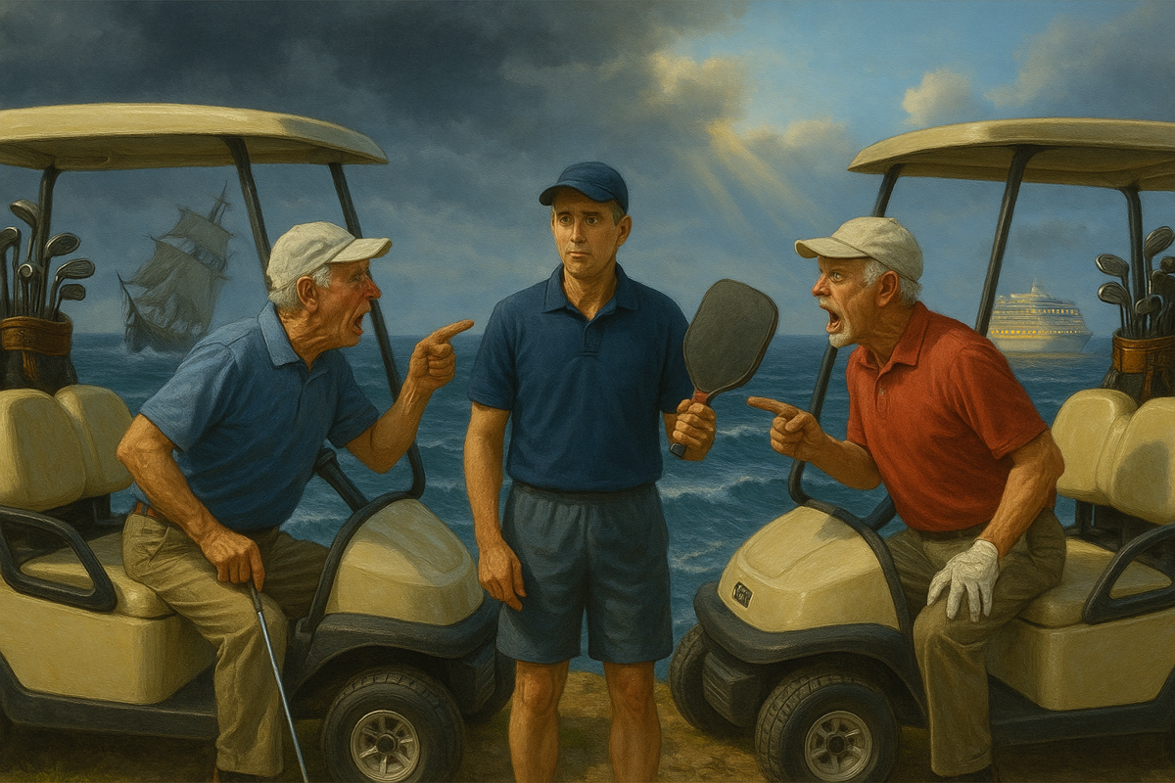

Slide 7
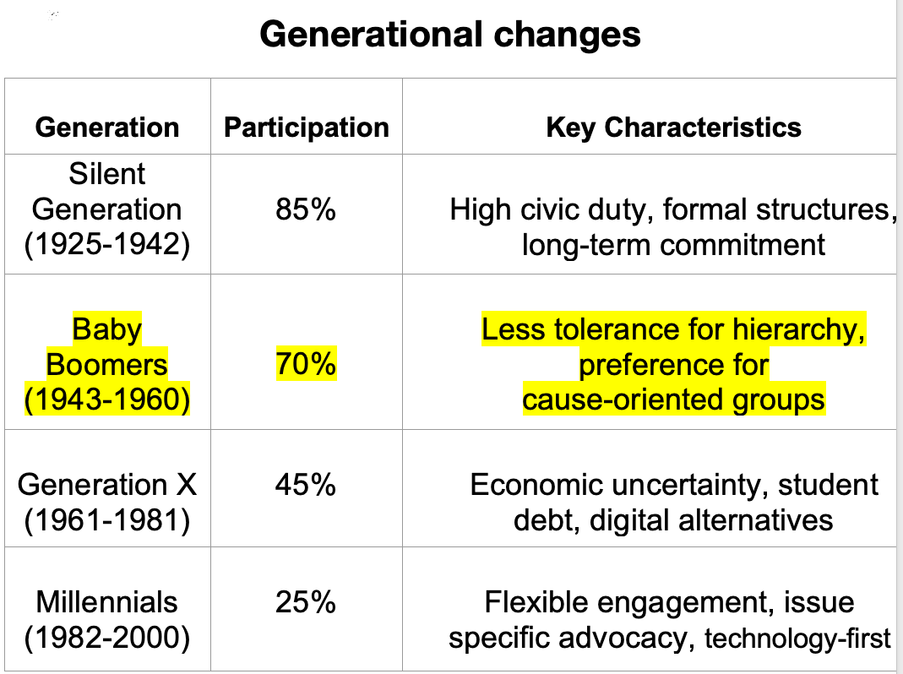
Will they Join?

Slide 8
Three SIR Benefits or “Hooks”
Enhanced Social Connections and Meaningful Relationships
A Sense of Purpose and Contribution
Improved Physical Health and
Active Lifestyles
It’s not ‘Come do what we do’, it’s ‘What do YOU want to do?”

Slide 9
Why New Members Will Join SIR
1. Friendships & Social Connections
Meet new friends your own age
Enjoy time with people who share your interests
Friendship is healthy — it helps you live longer
Message: “New Friends, Shared Fun”

Slide 10
Why New Members Will Join SIR
2. Purpose & Giving Back
Feel useful and valued
Share your skills and life experience
See the difference you make right away
Message: “Use Your Talents, Make an Impact”

Slide 11
Why New Members Will Join SIR
3. Staying Active & Healthy
Keep moving — walking, golf, hiking, biking
Stay sharp in mind and spirit
Being active together makes it easier (and more fun!)
Message: “Stay Active, Stay Young”

Slide 12
INVITE not Sell
Activity-first: “Join us for a casual [activity] next week — my guest.”
Friendship-first: “Great guys, good laughs, no heavy lifting.”
Well-being-first: “Staying active and connected is the point—we make it easy.”

Slide 13
Boomers will Join!
They are less interested in clubs with rigid traditions and more attracted to organizations where they can have an immediate and visible impact
Clubs that adapt to these preferences—offering diverse activities, opportunities for personal impact, and flexible involvement—are more successful in attracting and retaining Boomers.

Slide 14


Slide 15
