Slide 1
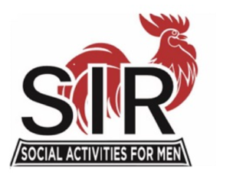


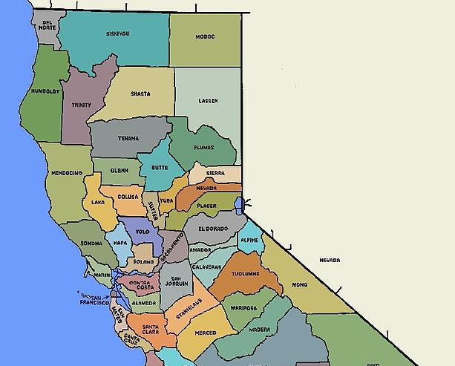
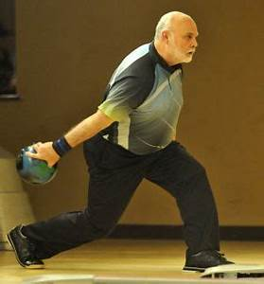
Activities
Live Longer- Live Healthier
Studies show you have a 70% less chance of developing cognitive disorders if you have an active social life
Activities Available
Through Local Chapters
May Include …
Golf
Bowling
Bridge
Poker
Cribbage
Dining Out
Interest Groups
Dominoes
Barbeques
Many of these Activities are Coed
What interests YOU?
What we DON’T do …
We don’t raise money;
We don’t have a political agenda;
We don’t have a religious orientation;
We don’t sell anything.
How to Contact Us
Visit sirinc.org for a listing of well over 100 local branches,
Branch is in your area.
Email
Contact
Phone
Other questions?
Visit www.sirinc.org
And use the Email Questions or Comment Link at the bottom of the first page and we will get back to you as soon as we can.
We hope you will contact us and visit a meeting near you soon
A Social Organization
for Men
Live longer and happier with good friends while enjoying fun activities
There is nothing else like SIR
Friendship, activities, physical, mental and social involvement and the opportunity to increase one's quality of life
Bocce Ball
Hiking
Walking
Trips to Casinos
Theater Events
Wine Tasting
Ladies’ Days
Pickle Ball
Trips to Ball Games
… and More!!!

Slide 2

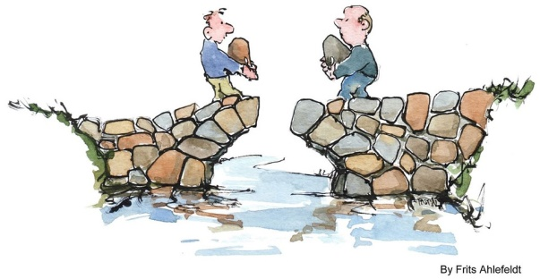

What is SIR?
Our mission:
To improve the lives of our members through fun activities and events while making friends for life!
SIR is a non-profit, public benefit corporation for men with 14,000 members in over 100 branches in Northern and Central California.
Come Build Friendships
Membership is open to men regardless of age, race, color, or religion. We are an all-volunteer organization.
Our Vision:
To become the preeminent active men's organization by improving longevity through providing opportunities for physical, mental and social engagement
Spouses and Partners
SIR branches have special luncheons, barbecues and parties which include wives, partners and guests and a lot of SIRs activities are co-ed.
Give your wife/partners a chance to also make their own friends for life
Make Friends for Life!
SIR branches provide a mix of activities like golf, bowling, bocce ball, card games, dining out groups, and many others...
Local chapters have monthly lunch meetings – good food, friendly conversation, and great speakers
Expectations of members are few.
Be a friendly, sociable guy
Have free time,
Participate in luncheons and activities,
Volunteer occasionally to help your Branch out
Introduce others to SIR so they can join in the fun …
Come join us, be part of the fun.
When my husband joined SIR it not only gave him a whole new circle of friends and activities, it gave me the same. We, as a couple, have met so many new great people. There are also so many activities for couples such as pot lucks, dine-out’s, golf, day trips, and wine tasting to name a few. SIR has added greatly to both of our retirements.
- Donna B.

