Slide 1
AN INTRODUCTION TO THE SPEAKERS EXCHANGE
Kevin King PBS
Branch 95 (El Dorado Hills)
December 6, 2022

Slide 2
Introduction
2-term Past Big SIR ( 2020-21) Branch 95 (El Dorado Hills)
About to begin 2nd year as Director at Large, newsletter editor and webmaster
Resource for other branches in the development of their websites
Developed and implemented a tool that a Little SIR or Program Committee can use to identify potential speakers
The tool – the Speakers Exchange – has been up and running on the SIR Inc. website since April

Slide 3
Benefits of a Speakers Exchange
It’s been found that dynamic speakers, speaking on a variety of interesting topics, is a key differentiator of highly successful branches and has been shown to help branches attract and retain members
Finding quality speakers each month is one of a Little SIR’s most important responsibilities and biggest challenges
A regular forum for exchanging ideas about other branches’ speaker experiences was found to be a helpful resource in my local area
That resource, while helpful, presented a number of its own limitations and challenges
Creating a speakers exchange program that’s more user friendly and scalable to include more speakers from a wider geographic area required a different way of thinking about the problem
Having such a system has the potential of giving a Little SIR more timely access to speakers and a larger pool of vetted speakers to choose from

Slide 4
The Process Which Various Branches May Use
Following a meeting, the Little SIR completes an evaluation form
Periodically, Little SIRs meet to pass out copies of the form to other Little SIRs and discuss those speakers in a roundtable format
While beneficial, the process relies heavily on paper and word of mouth for a Little SIR to identify potential speakers

Slide 5
The Speakers Exchange Program
Following a meeting, a Little SIR completes and submits a speaker assessment using Google Forms
Information from the form is automatically stored in a Google Sheets spreadsheet which is stored in a central repository
Little SIRs from other branches immediately have access to that speaker assessment as well as speaker assessments from other branches from around the State allowing them to narrow down potential speaker candidates for their next meeting

Slide 6
Accessing the Speakers Exchange

Slide 7
Speakers Exchange Webpage

Slide 8
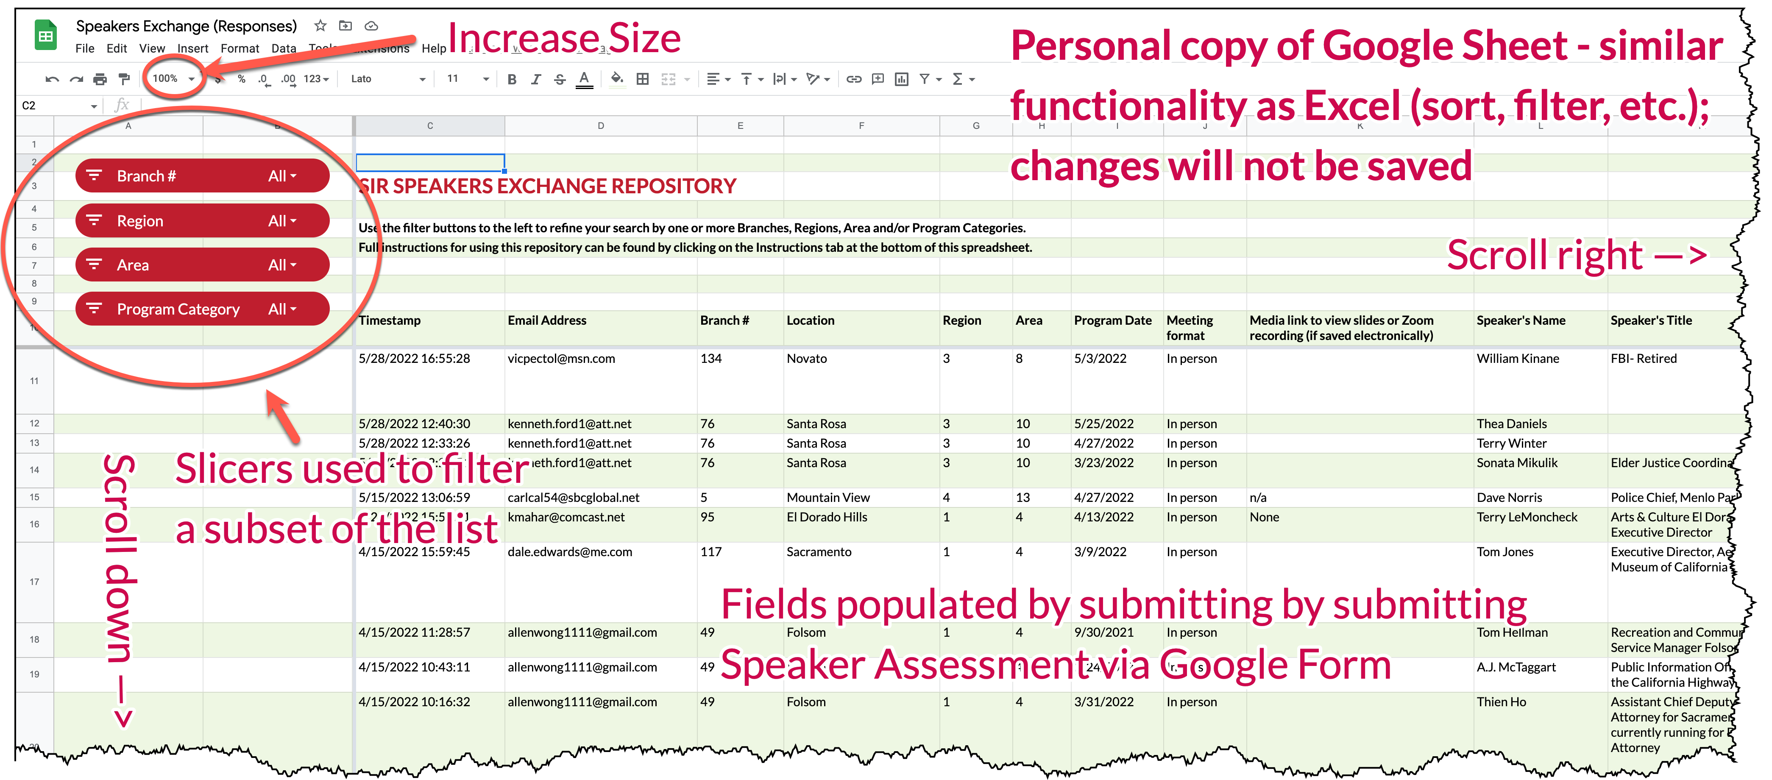
Speakers Exchange Repository

Slide 9
Demonstration of the Speakers Exchange
I’ll provide a brief demonstration of the use of the various elements of the Speakers Exchange
Q&A
For further information or questions about the Speakers Exchange, contact Kevin King at kmking00@gmail.com

