Slide 1
The Value of “Ordinary Ideas” to Solve Declining Membership
?

Slide 2
The majority (82%) of growth companies in an HBR study reported that the exceptional execution of an ordinary idea lead to their success!
Could the same be true for SIR?

Slide 3
Is declining membership in SIR
our major problem?
Or is it a symptom?

Slide 4
IF it is a symptom
What are the ROOT causes and how do we solve them?

Slide 5
Declining membership is caused by more members leaving than new members joining!
Why do members quit?
Why do people join?
The 5 Why’s

Slide 6
Our Membership Life Cycle
1
2
ATTRACT Guests
With
?
PROMOTE Your Branch
4
VALUE
Maintain Member’s Interest and INVOLVE them
3
CONVERT Guests to Members and INTEGRATE them
Notes:
Central image from www.presentationgo.com

Slide 7
Integration includes explaining what we Expect of a New Member
MAKE FRIENDS
be Sociable
PARTICIPATE
in our activities and events
BRING GUESTS
So they too can enjoy the benefits of SIR
HELP when asked
Branches are run by volunteers

Slide 8
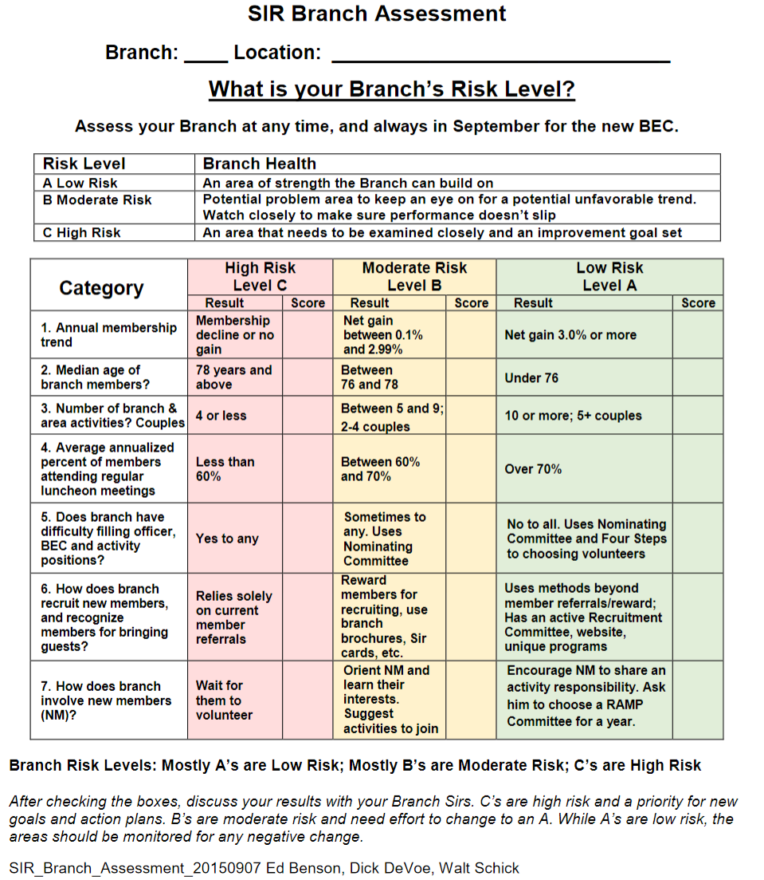
https://sirinc.org/MemInfo/BrAreaTools/branchassessment/BranchAssessment_20150907.pdf
2
4
1
3 & 4

Slide 9
Did the Branch Assessment indicate that any of the MLC quadrants was a weak link at your branch?
If so, you know where to start!

Slide 10
The majority (82%) of growth companies in an HBR study reported that the exceptional execution of an ordinary idea lead to their success!
Could the same be true for SIR?
If so, what are these successful ‘ordinary ideas’?

Slide 11
Each branch should generate its own ‘ordinary ideas’ to solve its own specific problems.
These Forums have provided many ideas which now need
“Exceptional Execution”

