Slide 1
SIR State Insurance

Slide 2
Today’s presenter is Craig Hoffhines.
Submit your questions using, Zoom Chat, found at the menu on the bottom. Send your question to “everyone.” They will be answered at the end of Craig’s talk.

Slide 3
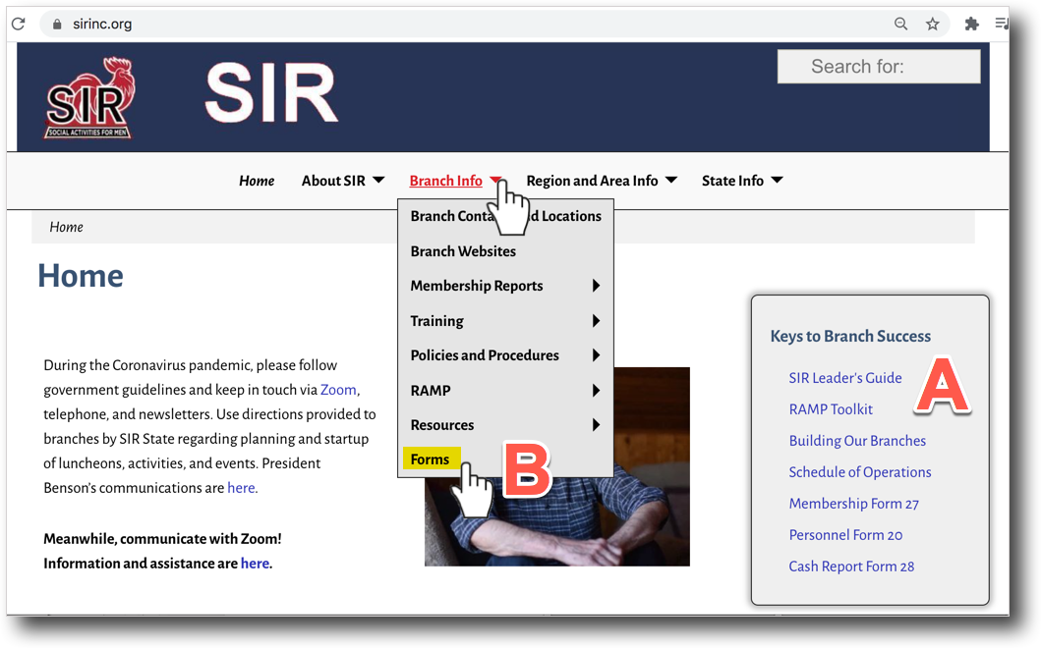
Link to all coverages is found under Keys to Branch Success in the SIR Leaders Guide
Link to all forms is found under ”Branch Info” at sirinc.org

Slide 4
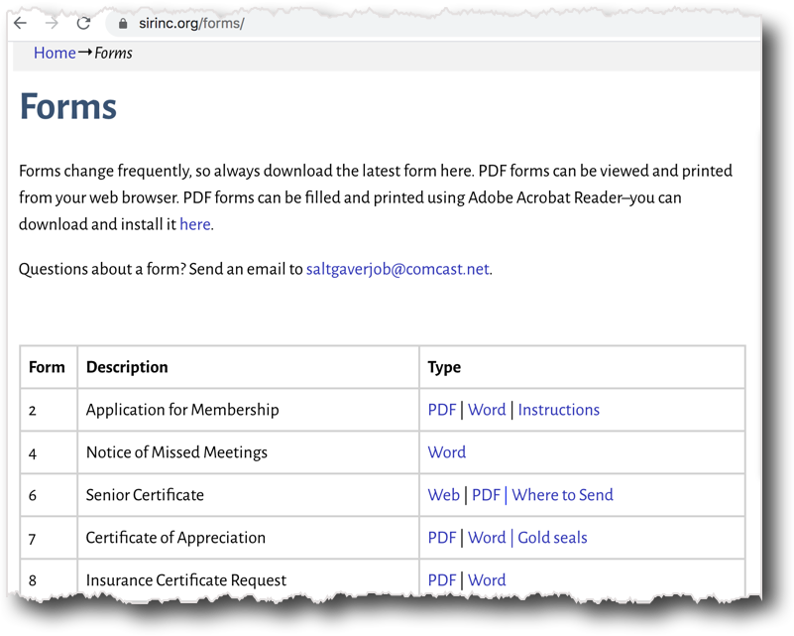
Scroll down the page to find the form you need.
The next slides will examine three forms …

Slide 5
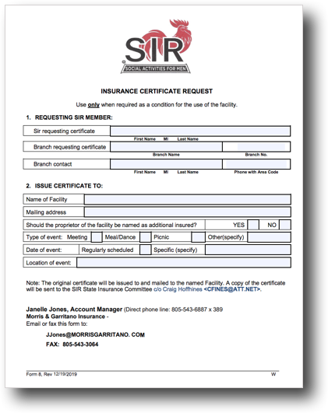

Slide 6
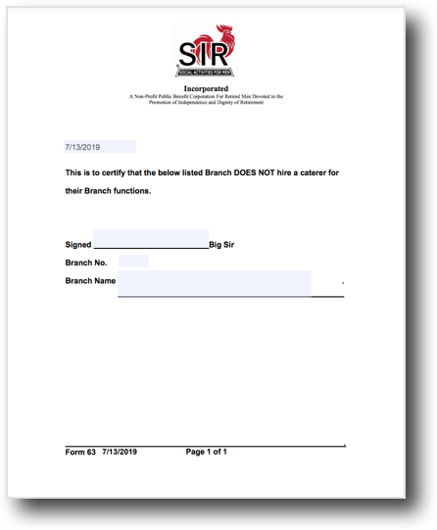
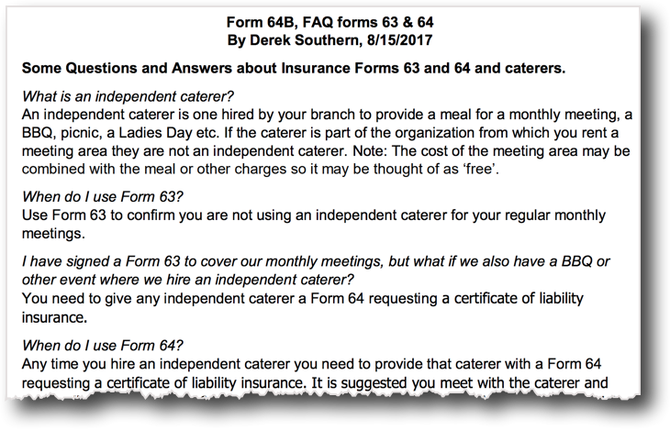

Slide 7
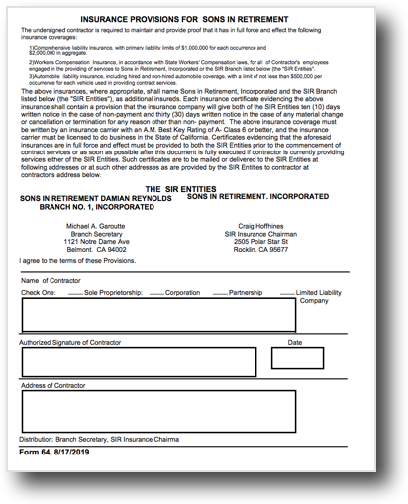

Slide 8
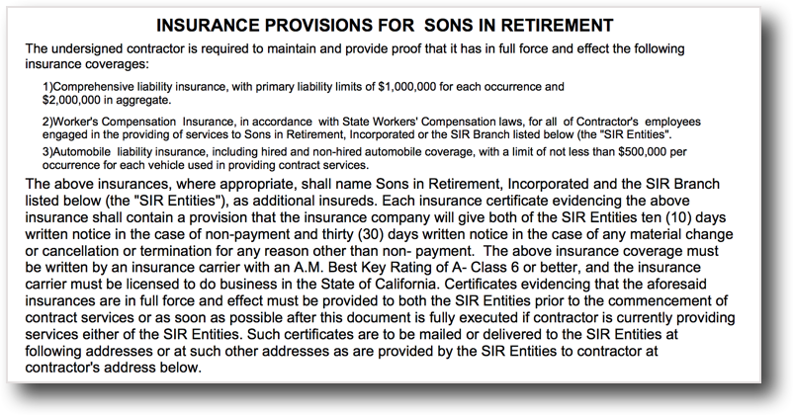

Slide 9
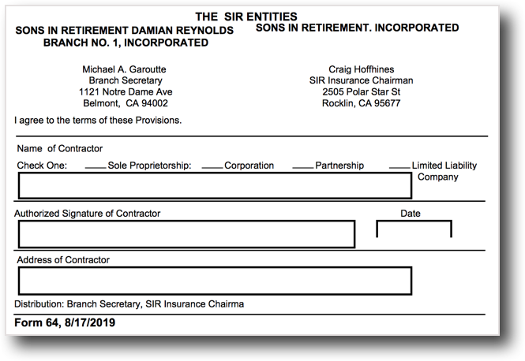

Slide 10
Final Questions ?

Slide 11
SIR State Insurance
Thanks for your attention
If you have any further questions you can contact Craig Hoffhines at cfines@att.net

