Slide 1
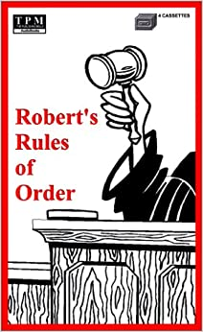

Robert’s Rules of Order
A method for conducting meetings that are fair, efficient, democratic and orderly.

Slide 2
What is SIR?
SIR (Sons in Retirement) is a non-profit, public benefit corporation formed for men.
SIR is a term used collectively refer to the parent 501(c)(4) corporation, Sons In Retirement, Incorporated, referred to as the State, and 100+ purposefully independent 501(c)(4) corporations referred to as Branches.

Slide 3
What is the Relationship between
SIR, Inc. and the Branches?
SIR, Inc. provides the structure to keep the Branches in conformance with CA law.
Each has a chief executive officer.
In the case of SIR, Inc., that person is the President.
In the case of the Branches, that person is the Big Sir.

Slide 4

How do Robert’s Rules of Order
Fit Into the Picture?
Both the State and the Branches conduct their formal business via Board or BEC Meetings
These meetings are carried out using Robert’s Rules of Order as the method for conducting the meetings.
The State and Branch Secretaries document the minutes of these meetings.

Slide 5
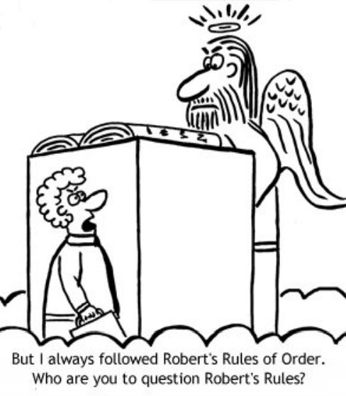

Slide 6
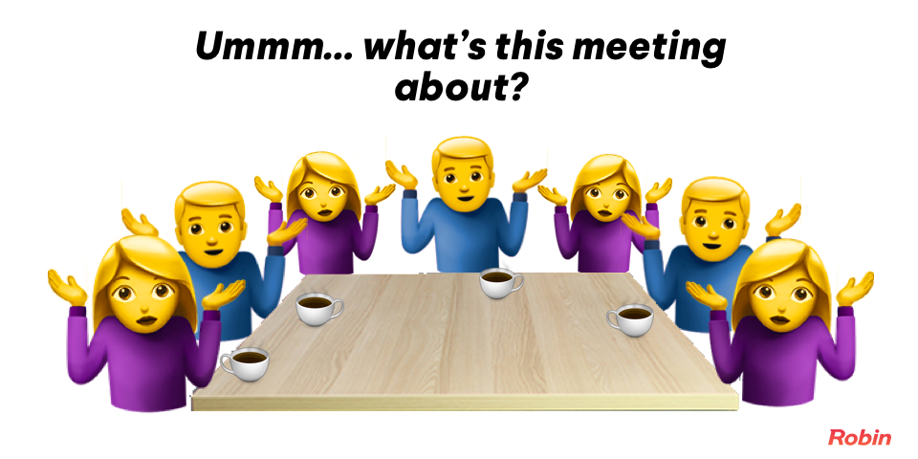
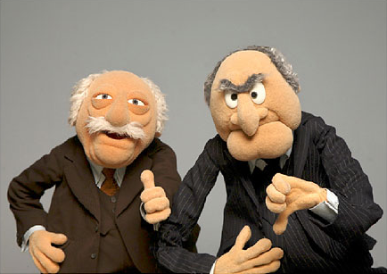
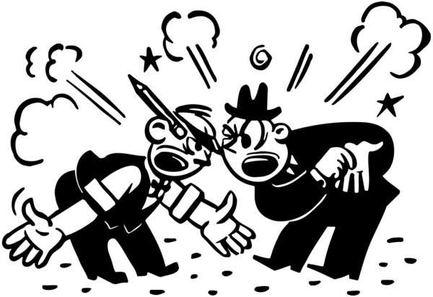
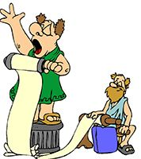
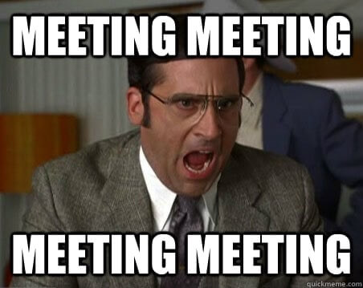
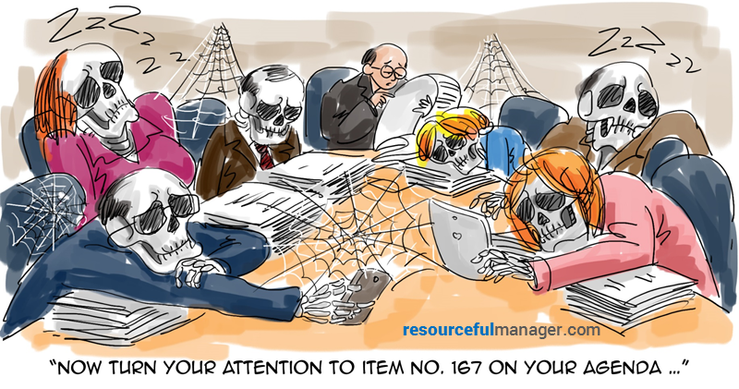
Bad Sometimes Meetings Can Be A Turnoff

Slide 7






What Constitutes a Good
Meeting?
A Good Meeting…
Is Organized
Allows
free dialog
Respects
everyone’s
opinions
Produces
consensus
Is well
documented
Finishes in
a timely manner

Slide 8
Tips and Reminders for the
Person Running the Meeting
Follow the agenda to keep the group moving toward its goals
Let the group do its own work, don’t over command
Control the flow of the meeting by recognizing members who ask to speak
Let all members speak once before allowing anyone to speak a 2nd time (mostly for large meetings)
When discussions get off-track gently guide the group back to the agenda

Slide 9
Tips and Reminders
(continued)
Model courtesy and respect, and insist that others do the same
Help to develop the board’s skills in parliamentary procedure by properly using motions and points of order
Give each speaker your undivided attention
Keep an emotional pulse on the discussions
Allow a consensus to have the final authority of the group

Slide 10
Meeting Agenda Suggestions
Before the meeting review items from the Schedule of Branch Operations (available on the SIR, Inc. website) https://sirinc.org/
1
Call the meeting to order
2
Determine that there is a quorum present
3
Request a motion to approve the minutes of the previous meeting, obtain a 2nd, vote to approve or amend

Slide 11
Meeting Agenda Suggestions
(continued)
4
Receive reports from branch officers, RAMP chairman, and various branch administrative & activity chairmen (including those not on the BEC)
5
Vote to approve all official reports
(e.g. Form 27, Form 28, Audit Committee, etc.)
6
Vote to approve branch activities annually, and any new activities throughout the year
7
Vote to approve new members & replacement board members

Slide 12
Meeting Agenda Suggestions
(continued)
8
Old Business
9
New Business
10
Adjourn meeting
11
Convene an “Executive Session” if needed

Slide 13
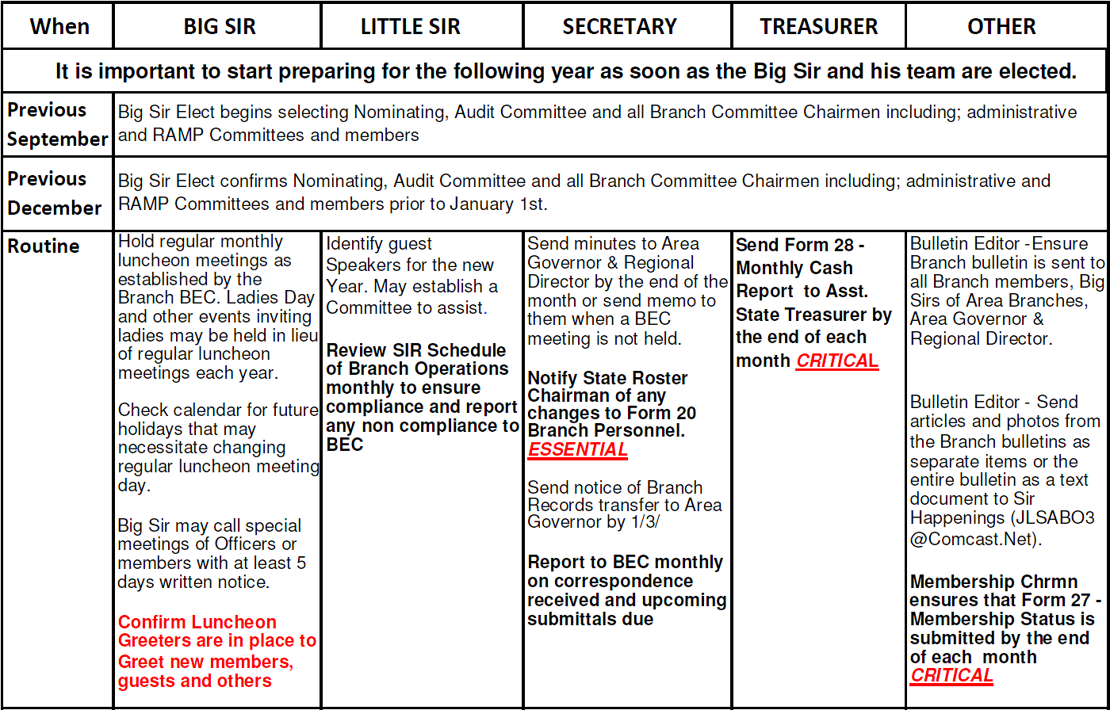
Annual SIR Schedule of BRANCH Operations
Revision 9/11/2020

Slide 14
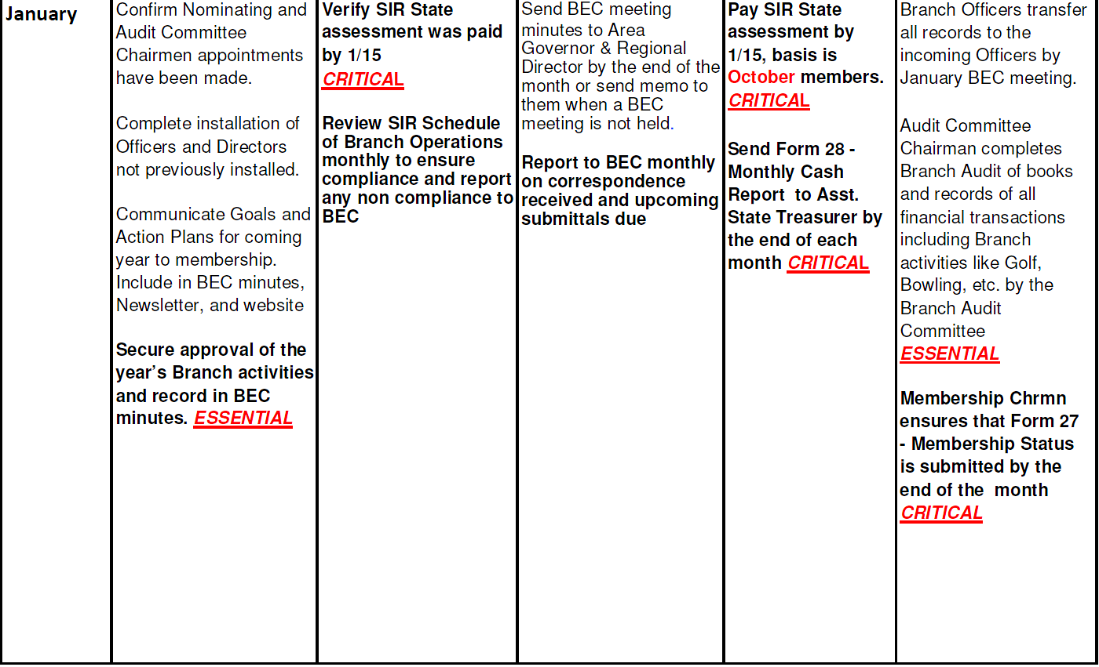
Annual SIR Schedule of BRANCH Operations
(continued in part)
Revision 9/11/2020

Slide 15
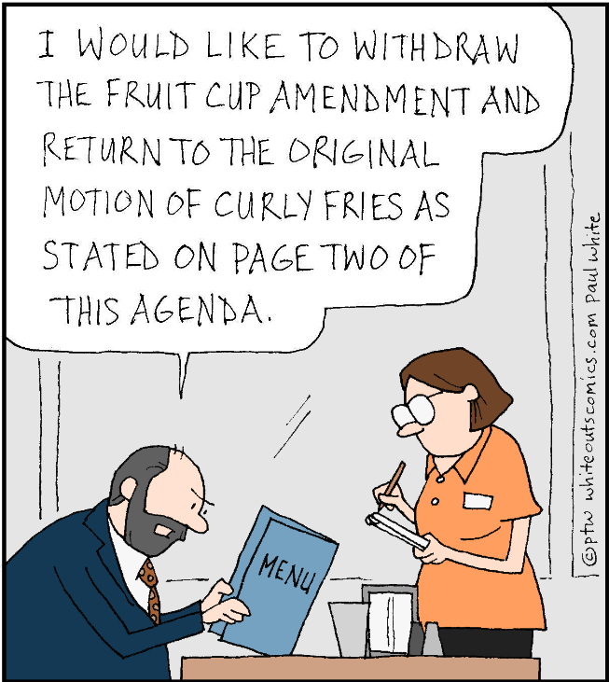
Robert’s Rules of Ordering

Slide 16
Questions so far?

Slide 17
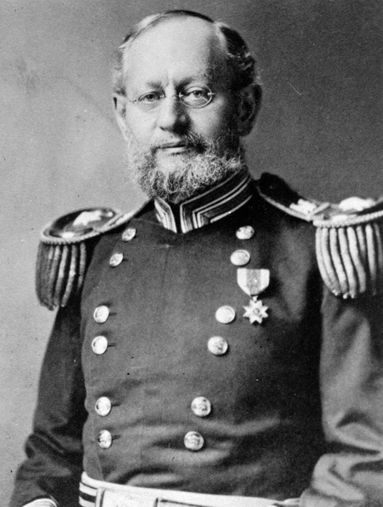
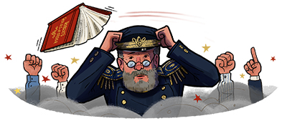
Who Was Robert?
Army Major Henry Martyn Robert, had bad experiences leading church meetings, so he decided to develop an organized and democratic method of conducting meetings.
The result was Pocket Manual of Rules of Order for Deliberative Assemblies, first published in 1876.

Slide 18
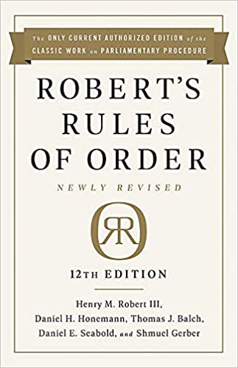
Robert’s Rules of Order
12th edition published in 2020
This newest version has about 650 pages of content!
  We will just cover the basics

Slide 19


Robert’s Rules of Order
Synonymous with Parliamentary Procedure
80% of all Organizations use Robert’s Rules as their Parliamentary Procedure
Robert’s Rules puts YOU in more control and allows consideration for all points of view.

Slide 20


Robert’s Rules of Order:
Motions
Types of motions
Main Motion
Introduce a new item
Subsidiary Motion
Change or affect how to handle a main motion (vote on this before the main motion)
Motion to Table
Kills a motion
Motion to Postpone
Delays a vote
(can reopen debate on the main motion)
Notes:
© Copyright PresentationGO.com – The free PowerPoint and Google Slides template library

Slide 21
Robert’s Rules of Order:
Going Through the Motions
1. Motion:
2. Second:
3. Restate motion:
4. Debate:
5. Vote:
6. Announce the Vote:
A member raises his hand to signal the chairman
Another member seconds the motion
The chairman restates the motion
The members debate the motion
The chairman restates the motion, then:
The chairman announces the result of the vote & any instructions
Asks for the the negative votes
Asks for the affirmative votes;
Each motion has 6 steps
TIP: If the board is in obvious agreement, the chairman may save time by stating “If there are no objections, we will adopt the motion to …” Then wait for objections. Then say, “Hearing no objections, (state the motion) is adopted.” And then state any instructions.

Slide 22
Robert’s Rules of Order:
Requesting Points
Certain situations need attention during a meeting, but they don’t require a motion, second, debate or voting. It is permissible to state a point during a meeting where the chairman needs to handle a situation right away.
Board members can declare a Point of Order, Point of Information, Point of Inquiry, or Point of Personal Privilege.

Slide 23
Robert’s Rules of Order:
Types of Points to Request
Point of Personal Privelige
Point of Order
Point of Information
Point of Inquiry
Draws attention to a breach of rules, improper procedure, breaching of established practices, etc.
A member may need to bring up an additional point or additional information (in the form of a non-debatable statement) so that the other members may make fully informed votes.
A member may use a point of inquiry to ask for clarification in a report to make better voting decisions.
A member may use a point of Personal Privilege to address the physical comfort such as room temperature or noise. Members may also use it to address the accuracy of published reports or the accuracy of a member’s conduct.

Slide 24
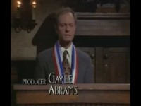
A Brief Demonstration

Slide 25
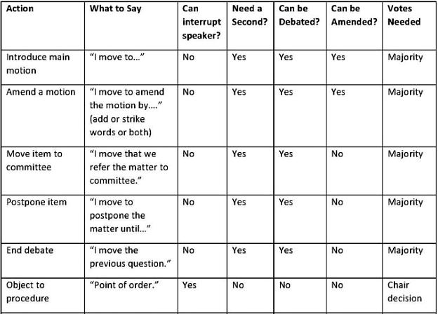
Robert’s Rules of Order
Cheat Sheet for Nonprofits

Slide 26

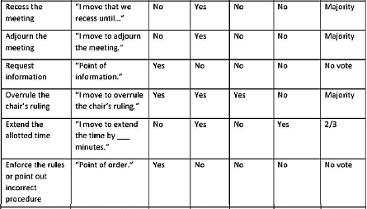
Robert’s Rules of Order
Cheat Sheet for Nonprofits

Slide 27
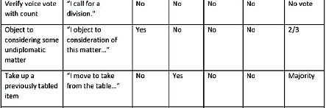
Robert’s Rules of Order
Cheat Sheet for Nonprofits

Slide 28
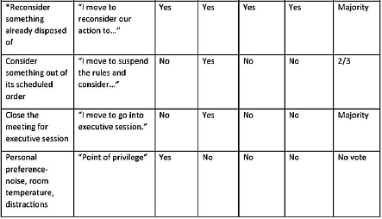
Robert’s Rules of Order
Cheat Sheet for Nonprofits
* A member may make a motion to consider something that was already disposed, however, the reconsidered motion may not be subsequently reconsidered. A motion to reconsider must be made during the same meeting and can extend to a meeting that lasts for more than one day.

Slide 29
Final Questions ?

Slide 30
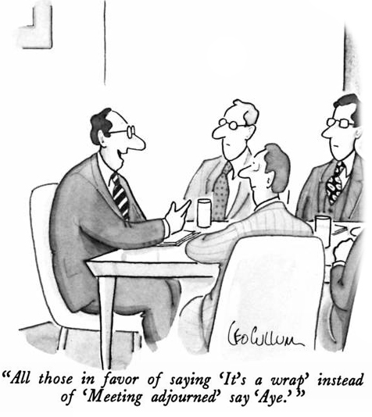
Meeting Adjourned
Thanks for your attention!
If you have any further questions you can contact me at bill.holly@comcast.net

