Slide 1
Using the Internet to Improve the Health of Your Branch
… It MAY also improve your own health …

Slide 2

What do we Need to be Doing During the Pandemic?
Maintaining an active organization
  BEC meetings
  Lunch meetings
Keeping communications with members open
  What happened last month
  What is planned for next month and future months
  Publicize activities (when they are allowed)
Communicating with External audience to attract new members

Slide 3






What Tools are Available?
OLDER
OLDER
USPS
Phone trees
Newsletters
NEWER
NEWER
Websites
& Email
Social media
Zoom

Slide 4
Email blasts!
Use Constant Contact

Slide 5
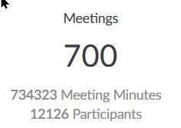
Zoom Usage Summary: May - December
That’s an average of about 60 attendees per meeting!

Slide 6
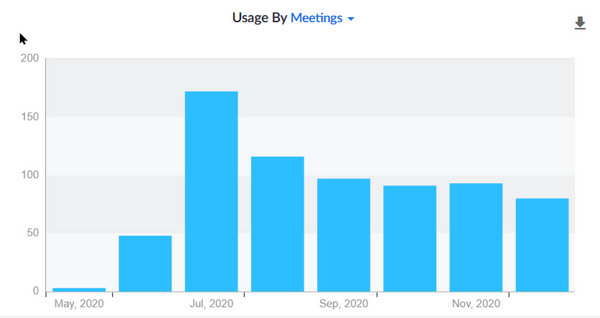
Zoom Usage: Meetings by Month

Slide 7
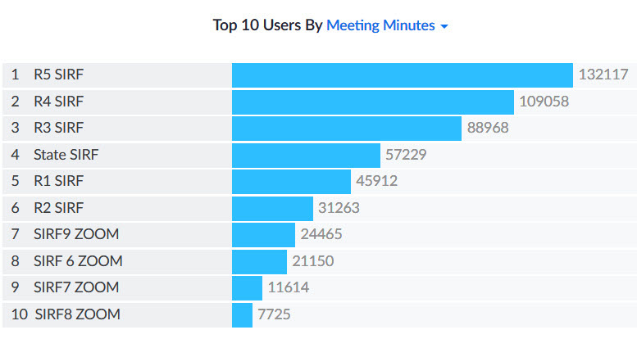
Zoom Usage: May - December

Slide 8
What are these Zoom Meetings about?
State Meetings
Region/Area meetings
BEC meetings
Pre-lunch breakouts
Lunch meetings with Speakers
Book discussions
Photography
Computers and Technology
Wine tasting (social time!)
Podcast discussions

Slide 9
How do I get a FREE copy of Zoom for my Branch?
The Sir Foundation owns 10 Zoom licenses. We want to approve any request from a Branch to have the use of a license.
Just send me an email and your Branch will be approved!
My email: derek.southern@gmail.com
I’ll provide you with the sign-in and password and some other information. It’s very simple, and we also offer training and support to get you up and running.

Slide 10
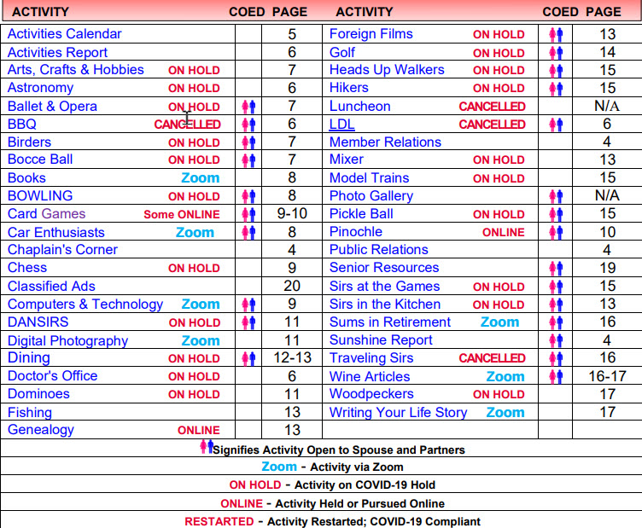
Keep Members Informed about Activities

Slide 11
Is Social Media Useful?
Facebook
Twitter
Instagram
LinkedIn
YouTube

Slide 12
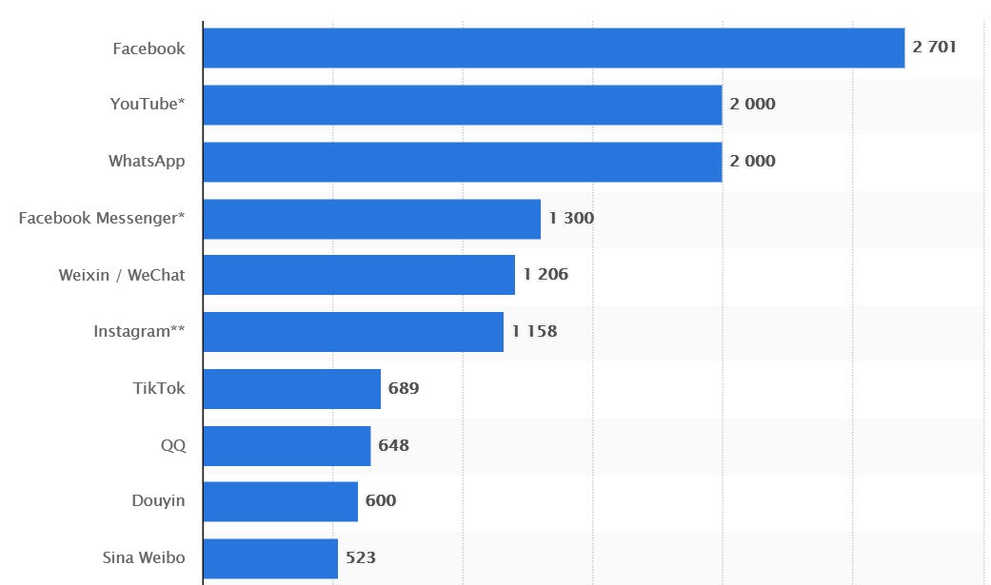
Top 10 Social Media, October 2020 (millions of users)

Slide 13
Facebook Age & Gender demographics
Except for those aged 65 and older, the majority of Americans use Facebook.
The network leans more towards women with 75% of women and 63% of men using the platform.
The breakdown of demographics by age include:
  68% of 50–64 year olds use Facebook
  46% of 65+ year olds use Facebook

Slide 14
YouTube Age & Gender demographics
YouTube’s usage by gender leans more towards men with:
  78% of men using YouTube
  68% of women using YouTube
The breakdown of demographics by age include:
  93% of 25–30 year olds use YouTube
  87% of 30–49 year olds use YouTube
  70% of 50–64 year olds use YouTube
  38% of 65+ year olds use YouTube

Slide 15
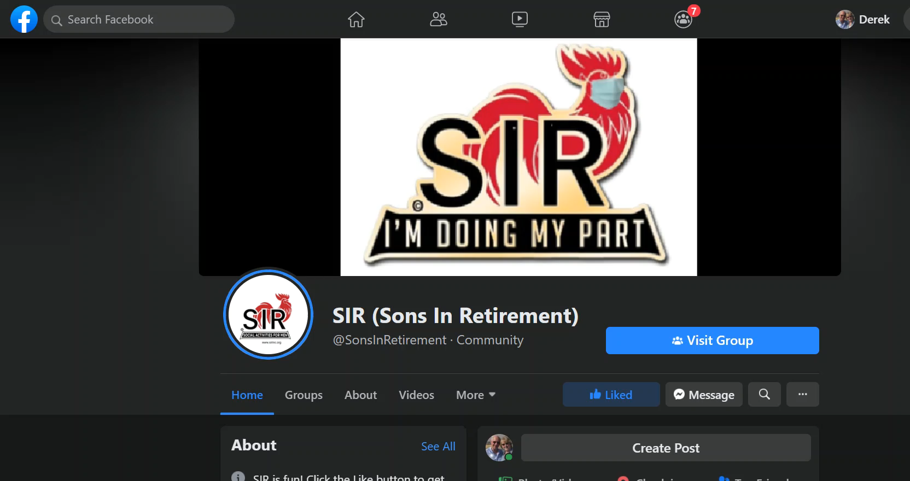

Slide 16
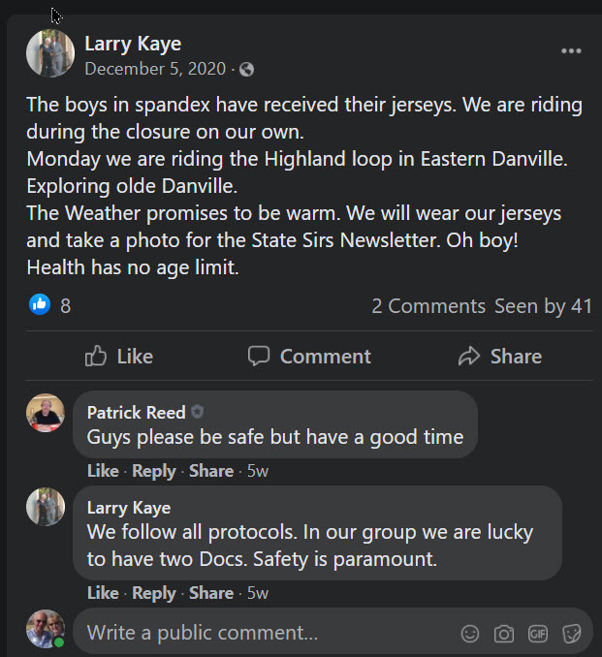
A recent addition from Branch 146 cyclists with guests from Branches
2 and 8

Slide 17
Best way to Learn to USE Social Media?
Search
YouTube

Slide 18
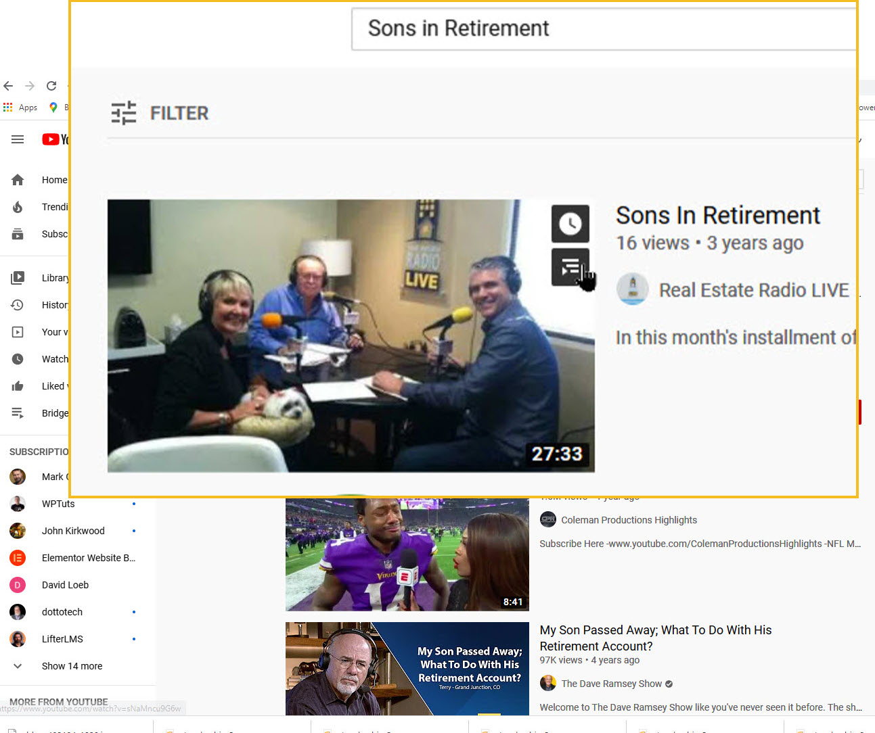
Simple search:
More results, but less specific

Slide 19
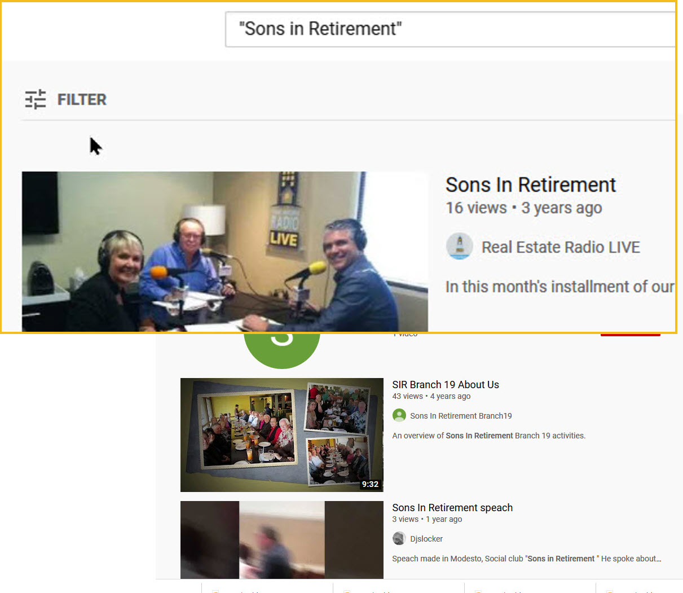
Filtered search:
more specific results

Slide 20
What Makes an Attractive Facebook Page?
Knowing who your audience is!
For members? Or recruiting? FOCUS
Interesting news
Lots of pictures
Keeping it up to date!

Slide 21
Website
Basic site available FREE from SIR Inc INFOSYS
Help is available from Sir Webmaster group
Create your own site. Hosting is FREE
(contact Alan Baker: alanbaker@gmail.com)
Decide if your audience is your membership, or is the site a recruiting tool? Best to focus.
Needs to be kept up to date
Space is essentially free so use plenty of images

Slide 22
Conclusion
There are many ways to use the Internet to maintain the health and integrity of your Branch.
Many are FREE or low cost
All require constant upkeep with refreshed content (otherwise, “Don’t waste your time”)
Learning new skills keeps your brain (and you) healthier and more active
Help is often available from other webbies!

