Slide 1

Form 20 & Recruiting Leaders
Dennis Pangburn, Region 3 Director

Slide 2

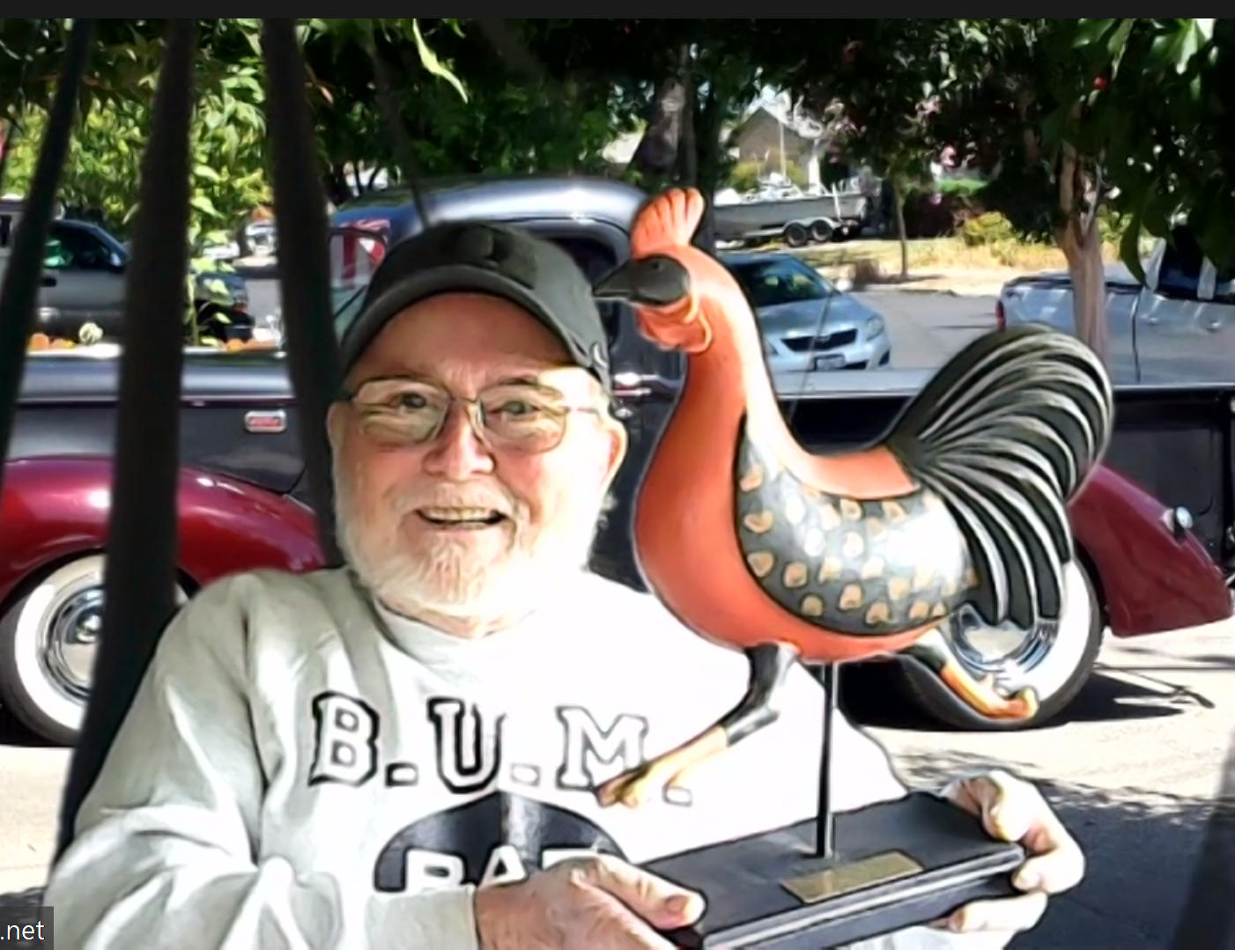

Slide 3
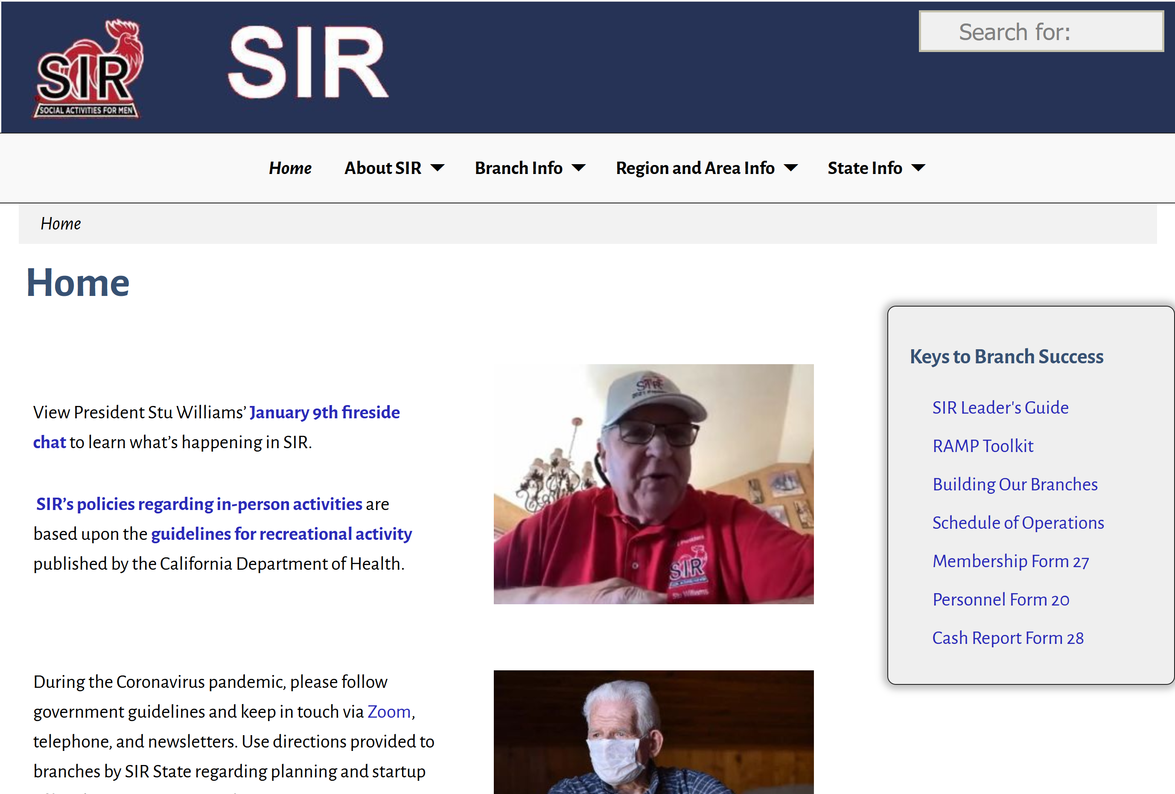

Slide 4
SIR Expectations of Members
Be a Friendly Sociable Guy
Participate in our Activities, Lunches and Events
Volunteer when Asked – Give it a Shot
Bring Guests to Perpetuate the Organization

Slide 5
SIR Expectations of Leaders
Exhibit Enthusiasm, Open Mindedness, Knowledge
Recognize Contributions of Others
Be a Skilled Problem Solvers
Be a Decision Makers

Slide 6
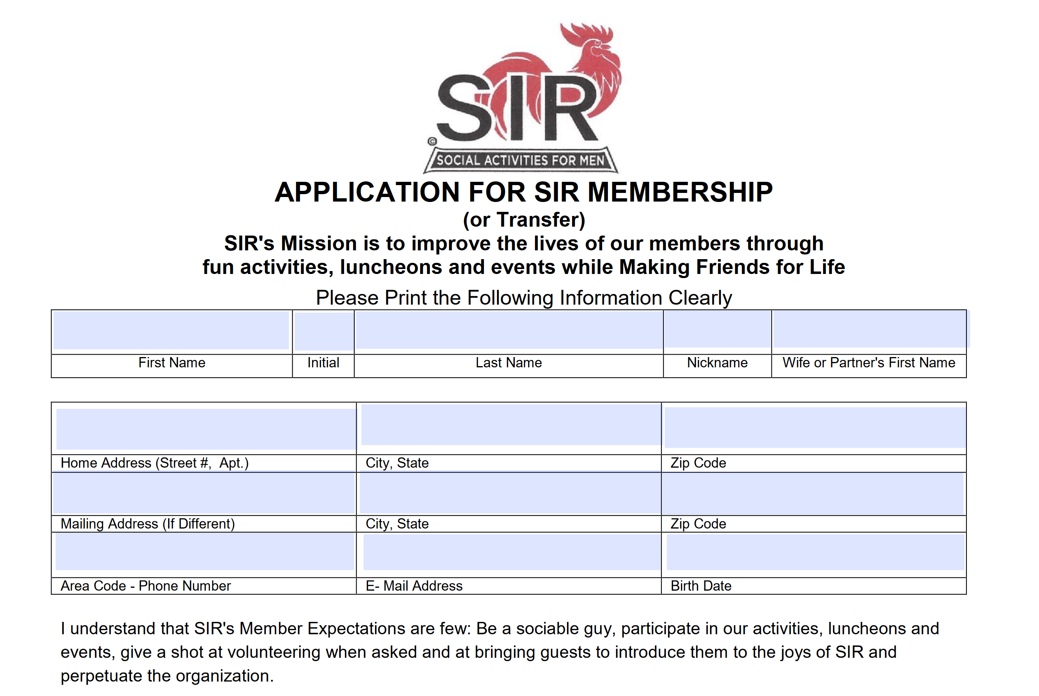

Slide 7


Slide 8
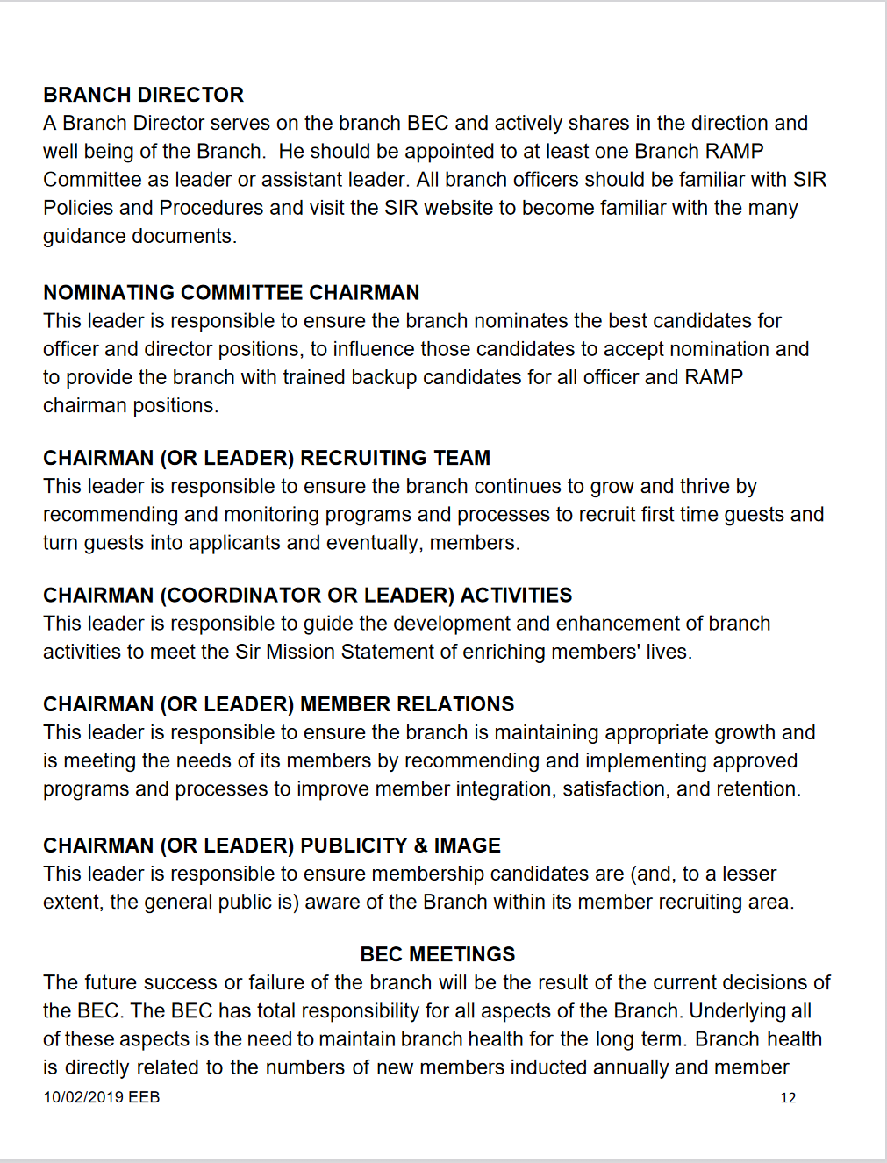

Slide 9
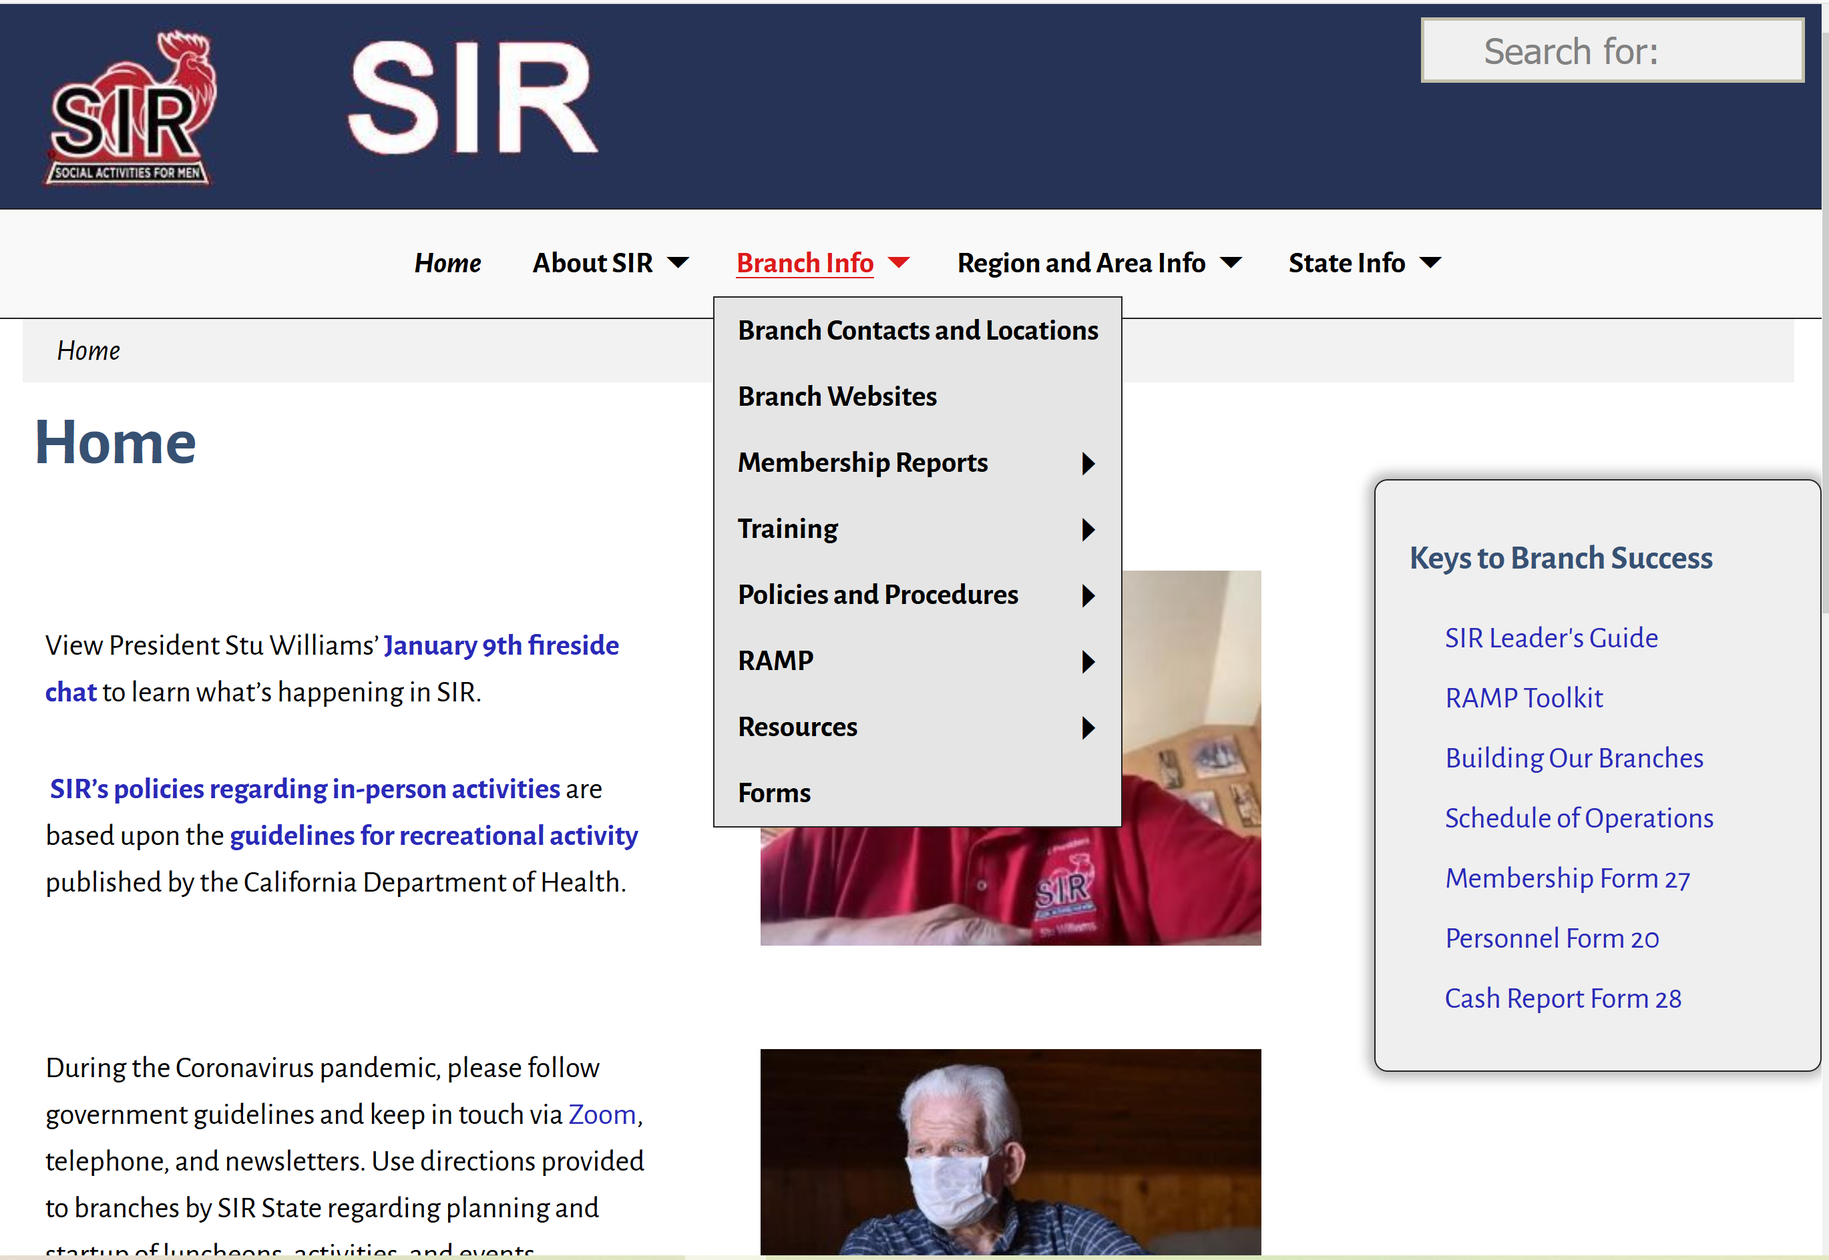

Slide 10
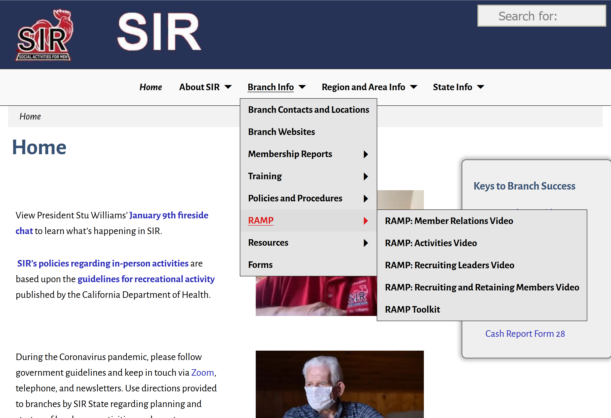

Slide 11
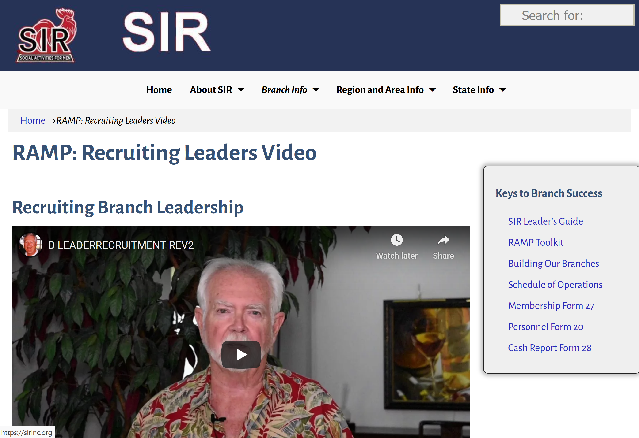

Slide 12
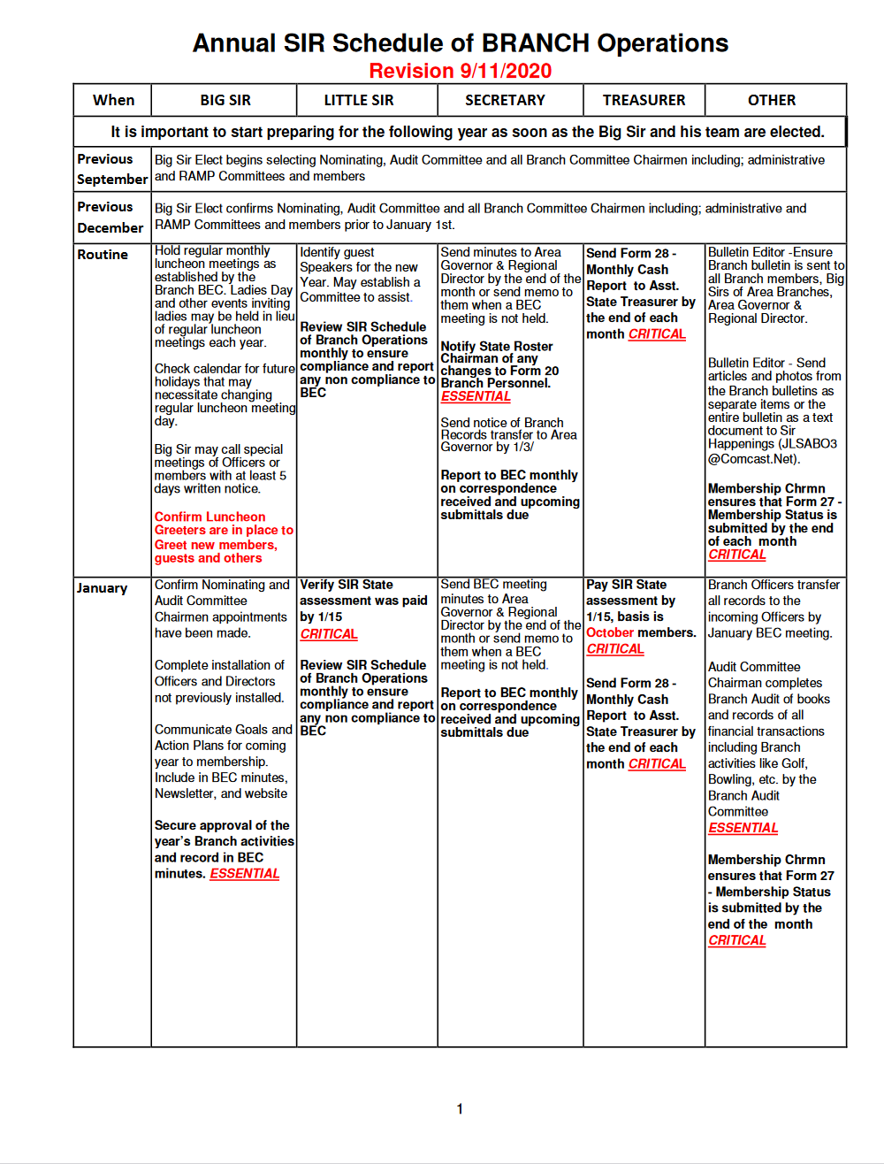

Slide 14
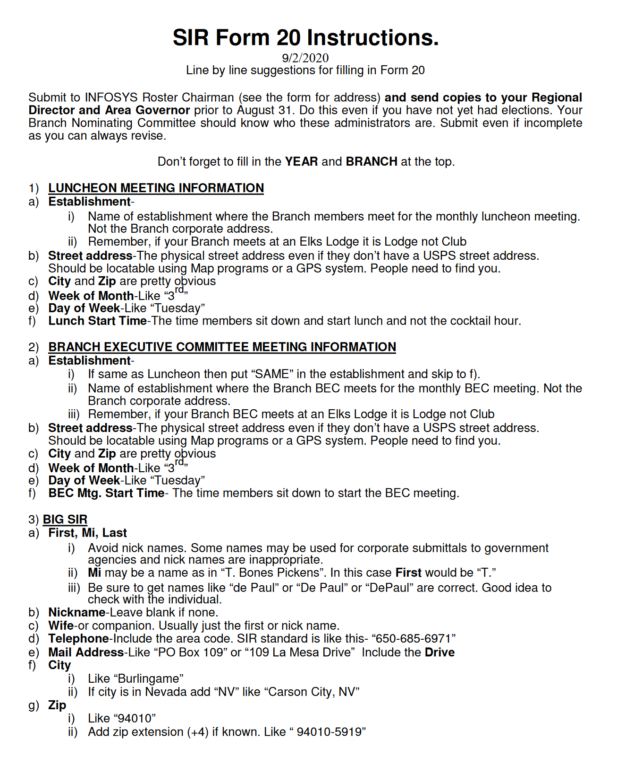
Form 20
Instructions

Slide 15
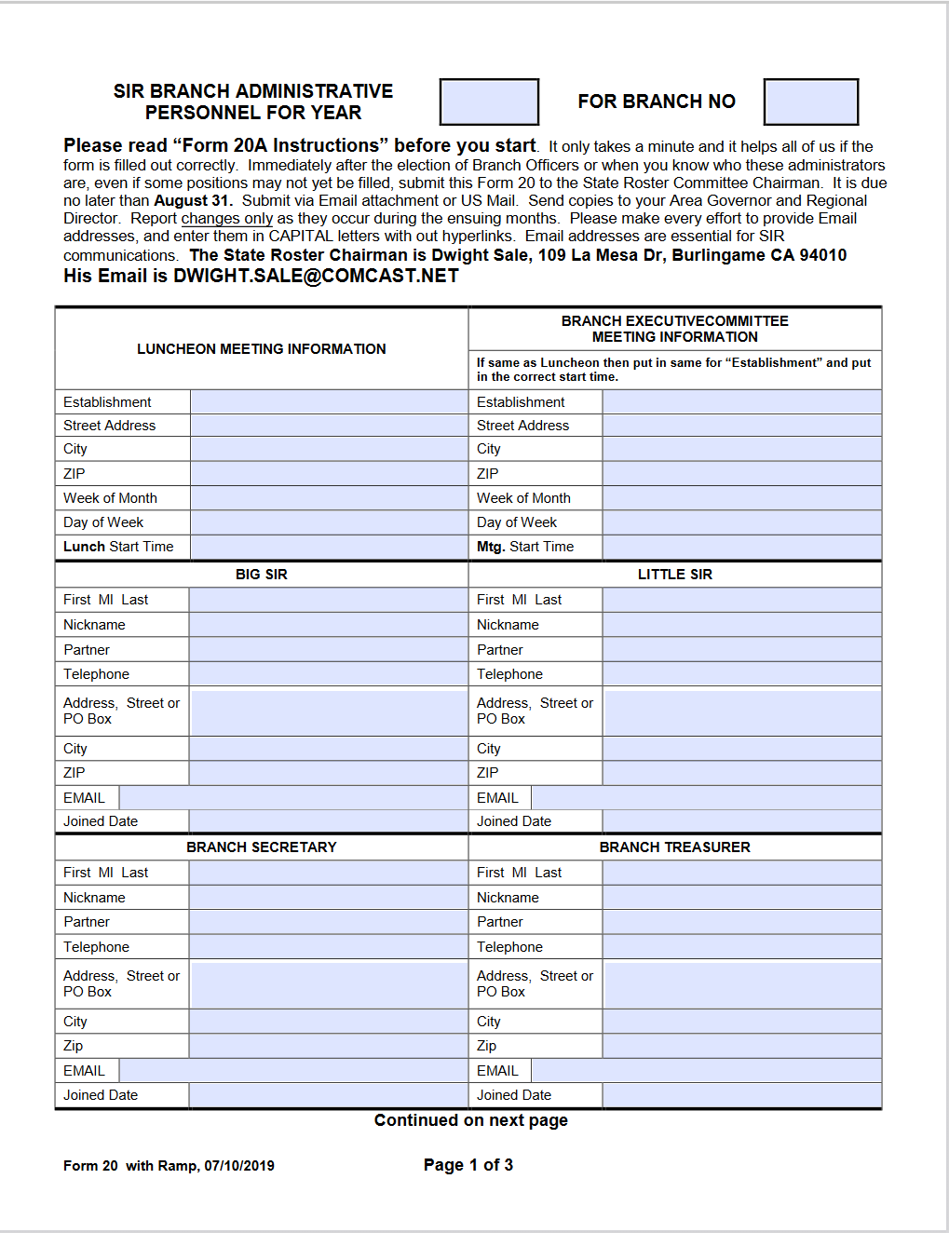
Form 20
Page 1

Slide 16
Form 20 & Recruiting Leaders
Dennis Pangburn, Region 3 Director
Pang1 @ comcast.net

