Slide 1
January 15, 2021

Slide 2
Summit Logistics
3 Quick Reminders
All microphones are muted except for the speaker.
Please check your display name is in the format: First name, Last name, Br # for attendance records. If not please update it in the ‘participants’ tab.
Questions can be submitted at any time by clicking on the ‘Raise Hand’ icon at the bottom of the ‘participants’ tab or using the ‘chat’ tab.

Slide 3
Opening the Summit
God Bless America
This Photo by Unknown Author is licensed under CC BY

Slide 4
Welcome Honored Guests
SIR Past Presidents

Slide 5
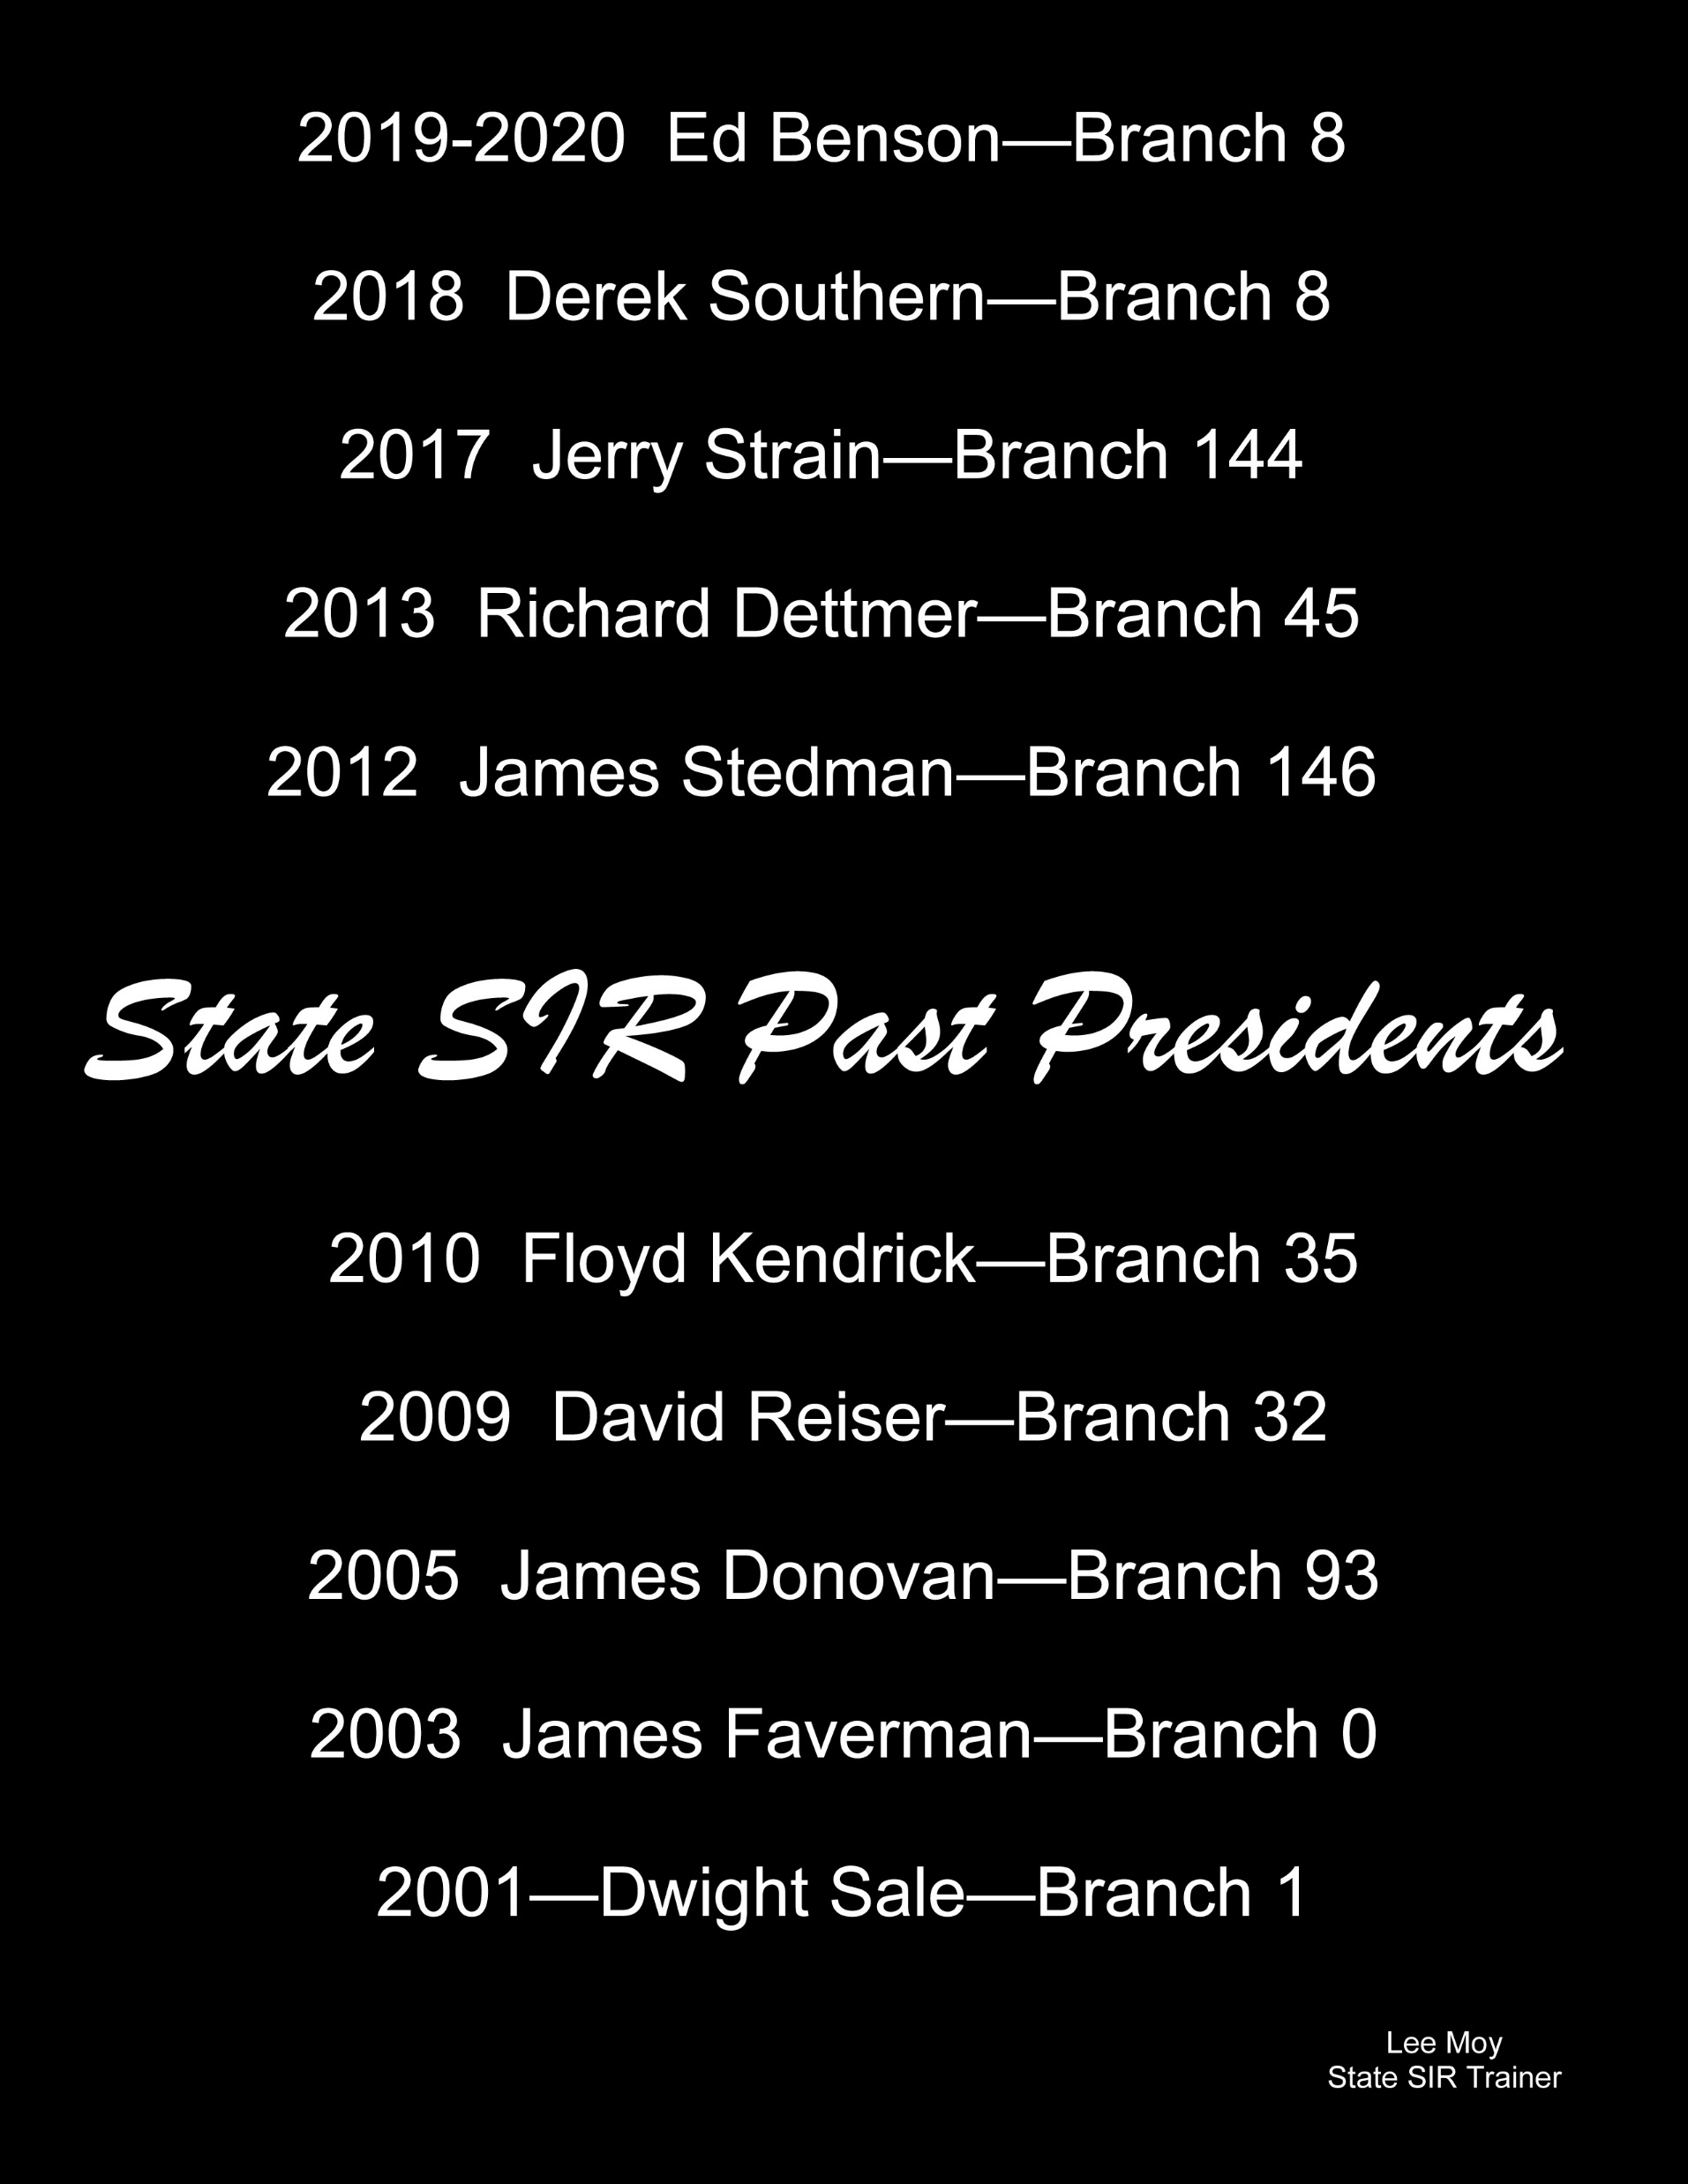

Slide 6
Opening the Summit
Let us Begin the Day

