Slide 1



Can SIR Inc.
Enrich Your Life?
WeAreSir.com
Notes:
ASK: How many people have heard of SIR? If a few respond that they know SIR ASK How they know. After the response(s) say: This is more than usually respond say they know of SIR, so I’m happy to see so many raised their hands. If no one says they know SIR, SAy: Don’t worry that’s why I’m here. We like to say SIR is the best kept secret in California. Since the pandemic we’ve decided it is important to introduce more people to SIR. Because we believe SIR can enrich your life.

Slide 2
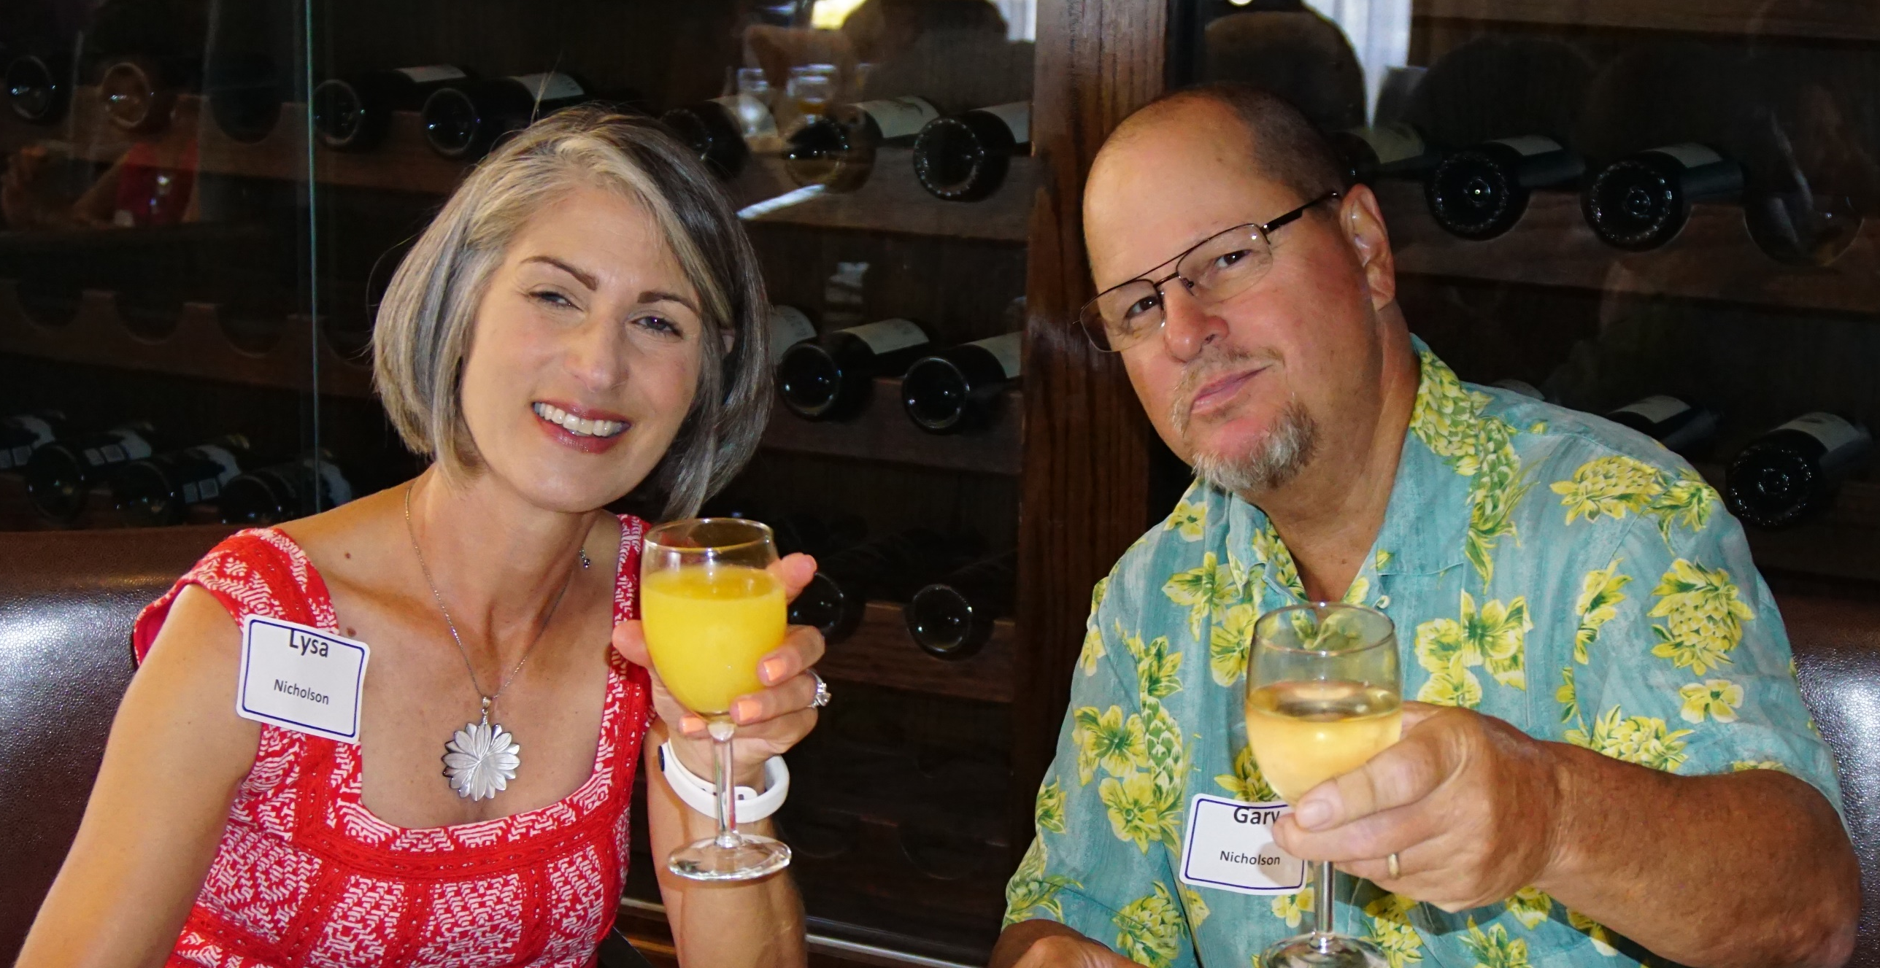


I’m a
SIR
Member
  I’m here because I love being a SIR.
  It has brought more value to my life.
  I would like to see others enjoy and experience SIR, so let me tell you about it!
Notes:
YOU CAN ADD HOW IT BROUGHT VALUE TO YOUR LIFE BUT DO NOT TALK ABOUT RETIREMENT AND ONLY SHARE POSITIVE SITUATIONS. DON’T SHARE HOW THEY WERE BAD BEFORE SIR, JUST WHAT SIR ADDED TO YOUR LIFE. AFTER READING AND TALKING ABOUT THE BULLETS SAY: This photo is representative of participating in SIR. No, not the drinking. But socializing definitely is representative of SIR.

Slide 3
We
Have
Fun
  SIR Inc. is a nonprofit social activities organization
  With Branches in Northern & Central California
  Each Branch chooses its own activities
  Branches add activities based on member interest
  Many Branches have more than 50 activities you can participate in
Notes:
AFTER READING AND TALKING ABOUT THE BULLETS SAY: The reason we exist is to have and hold activities. IF YOU WANT TO GIVE MORE INFORMATION: SIR is a 501 © (4) which is one of the nonprofit corporation categories designate because they benefit society.

Slide 4
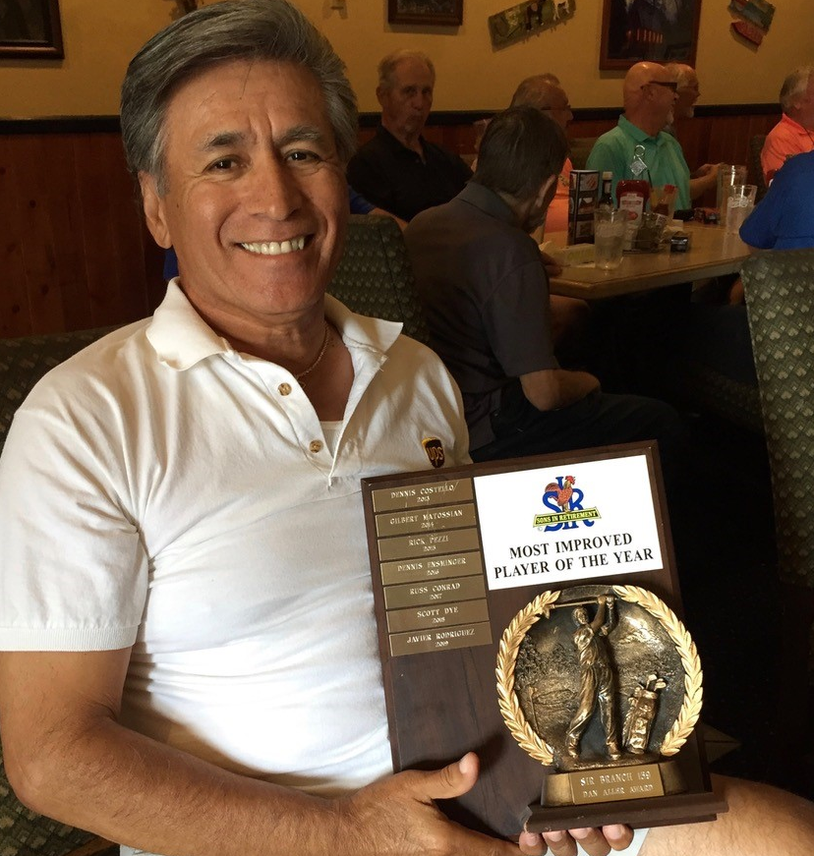
Member
Activities
  At SIR Golf is most popular with 4,000 golfers
  registered with the Northern California Golf Association (NCGA). Making SIR the most prominent men’s group with NCGA.
Bowling
Poker
Bridge
Dining out
Barbecues
Bocce ball
Hiking
Holiday events
Cooking classes
Wine tasting
RV-ing
Luncheons
Pickle ball
Walking groups
Travel
Tournaments
Notes:
AFTER READING AND TALKING ABOUT THE SLIDE, SAY: In addition, there are Photography groups, Fishing, Computer groups and many other activities not listed. If you’re a golfer, being the largest men’s group in NCGA means SIR Members get their lowest fees.

Slide 5
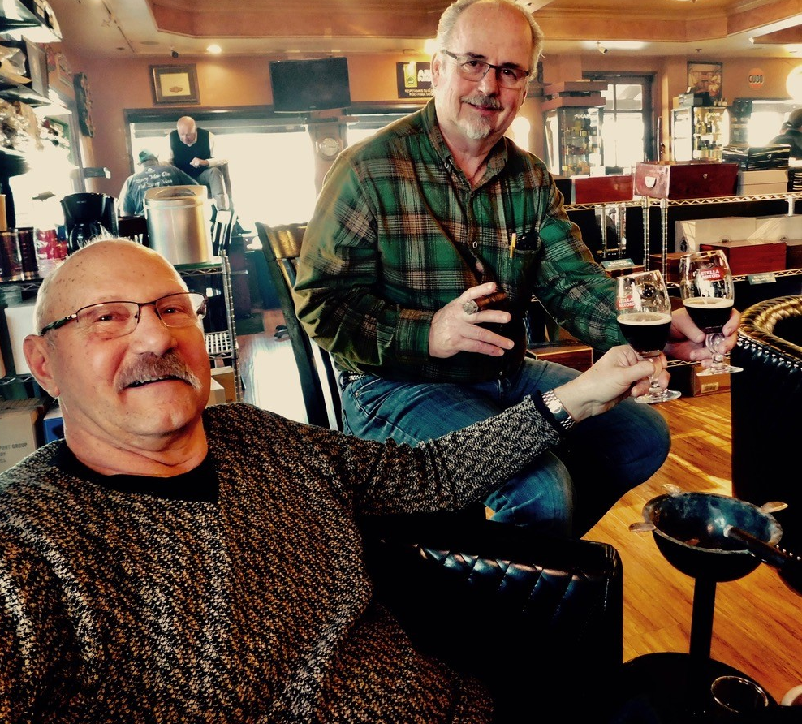
Branch xxx
(name of city)
Activities
Golf
Bowling
Poker
Bridge
Dining out
Barbecues
Bocce ball
Hiking
Cooking classes
Wine tasting
RV-ing
Luncheons
Pickle ball
Walking groups
Travel
Holiday events
Notes:
AFTER READING AND TALKING ABOUT THE SLIDE SAY: These are some of the activities for the SIR Branch I belong to. Each branch can create their own events, so events may vary from Branch to Branch.

Slide 6
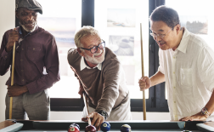
We
Socialize
The premise for SIR is that we are all
better actively engaged with
Friends and making new ones through activities.
As a group, we want to have fun!

Slide 7

Let’s Talk Benefits
We like to say at SIR you’ll
Make Friends for Life!
We also believe
SIR will
Enrich Your Life!
Notes:
After Reading and talking Say: This is our opinion, but there is data to support the opinion that SIR has benefits. Consider this…

Slide 8

Engaging with
Others
According to Harvard Health Publishing, “research increasingly shows that strong social ties are crucial to your brain health. Socializing can stimulate attention and memory and help to strengthen neural networks. You may just be laughing and talking, but your brain is hard at work. This increase in mental activity pays off over time.
Scientists have found that people with strong social ties are less likely to experience cognitive decline than people who spend most of their time alone.”
https://www.health.harvard.edu/blog/3-ways-to-build-brain-boosting-social-connections-202109082585#:~:text=Research%20increasingly%20shows%20that%20strong,activity%20pays%20off%20over%20time.
Notes:
AFTER READING AND TALKING ABOUT THE SLIDE SAY: SIR helps provide these social ties. Most Branches have a luncheon with speaker that are different every month and include sports anchors, authors, former fighter pilots and mayors. Some of the Branch activities introduce you to new skills or take you on adventures. SIR engages your brain too!

Slide 9
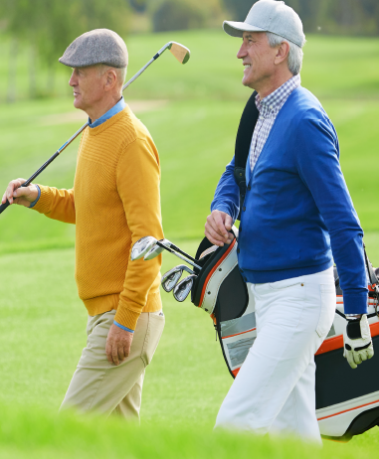
Friends
Are
Important
Mayo Clinics says having friends:
Increases your sense of belonging and purpose
Boosts your happiness and reduces your stress
Improves your self-confidence and self-worth
Helps you cope with various life’s traumas
(https://www.mayoclinic.org/healthy-lifestyle/adult-health/in-depth/friendships/art20044860#:~:text=Boost%20your%20happiness%20and%20reduce,drinking%20or%20lack%20of%20exercise)
Notes:
AFTER READING AND TALKING ABOUT THE SLIDE SAY: I’ll just ask you to remember what I said just a few slides ago I noted that, many of us, the members, say “you make friends for life at SIR.” so I believe we have checked the box marked friends.

Slide 10
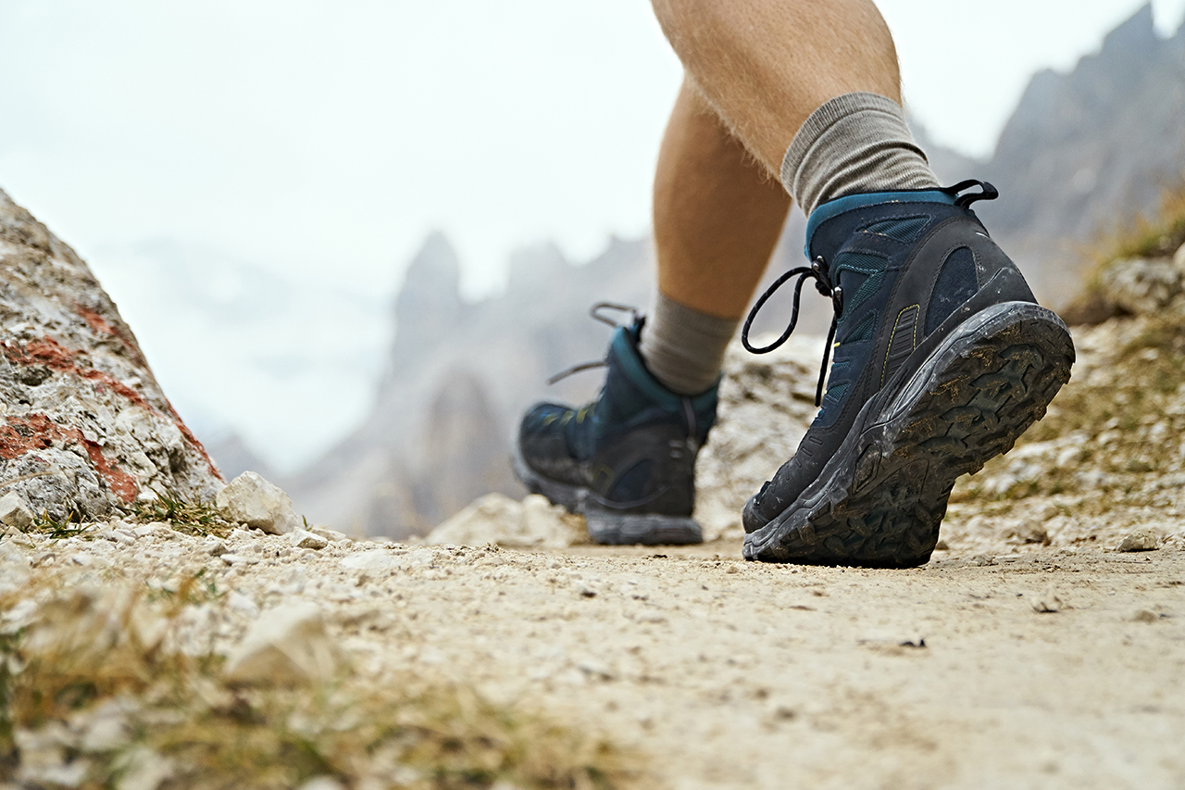
Being
Active
  The CDC says regular physical activity
  is one of the most important things you
  can do for your health.
  Being physically active can improve
  your brain health, help manage weight, reduce the risk of disease, strengthen bones and muscles, and improve your ability to do everyday activities.
  https://www.cdc.gov/physicalactivity/basics/pa-health/index.htm#:~:text=Being%20physically%20active%20can%20improve,activity%20gain%20some%20health%20benefits.
Notes:
AFTER READING AND TALKING ABOUT THE SLIDE SAY: All our activities are not physical, but we do have hikers, walkers and pickle ball groups. Personally, post pandemic, I’m happy just getting out of the house.

Slide 11

Bonuses
  The lowest golf fees available because SIR is one of the largest groups with NCGA
  Your calendar will be full
  You’ll meet new people
  Find new things to do
  Choose from a large group of activities

Slide 12
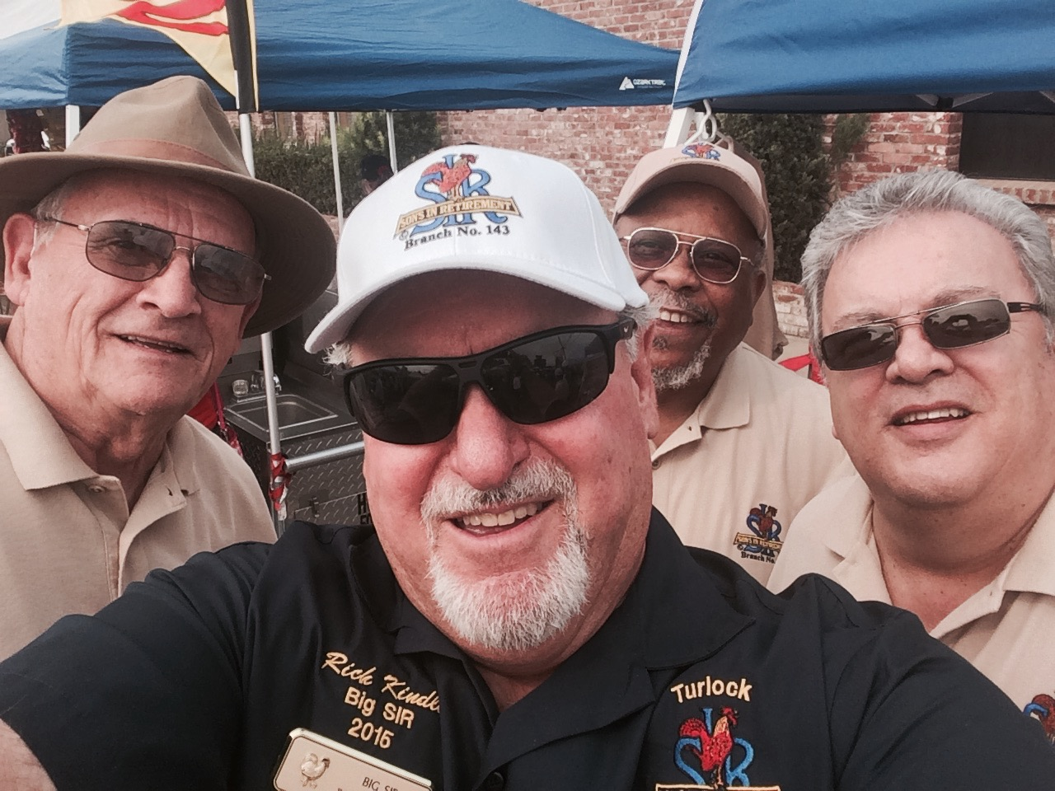
Find
Us
Online
  WeAreSIR.com
  On Facebook
  @SIRSocialActivities
  Please “like” our page!
Notes:
AFTER Reviewing the slide information, SAY: In fact, let’s do a little social media right now! Is that OK? (Wait for response) I’ll just take a few selfies right now. OR JUST ASK IF YOU CAN TAKE PHOTOS OF THE ROOM TO POST LATER. THEN DO IT. TEXT THEM RIGHT THEN OR LATER TO MARY ODBERT AT 916-743-3113 (DO NOT GIVE THIS NUMBER OUT!) WITH INFORMATION ABOUT THE GROUP, WHO YOU ARE, WHERE AND WHEN IT WAS TAKEN.

Slide 13
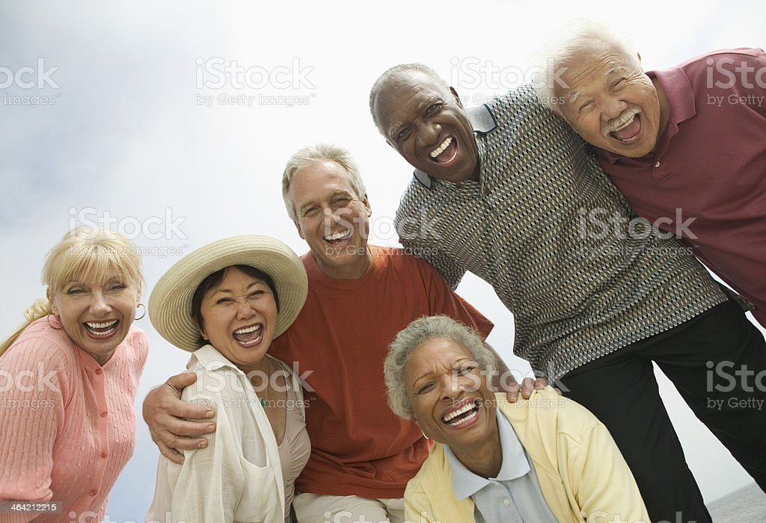
About
SIR Inc.
    SIR was founded in 1958.
    Today, many Branch activities are coed, and the Branches welcome guests.
    While members are men 50+, we encourage women to participate as guests.

Slide 14
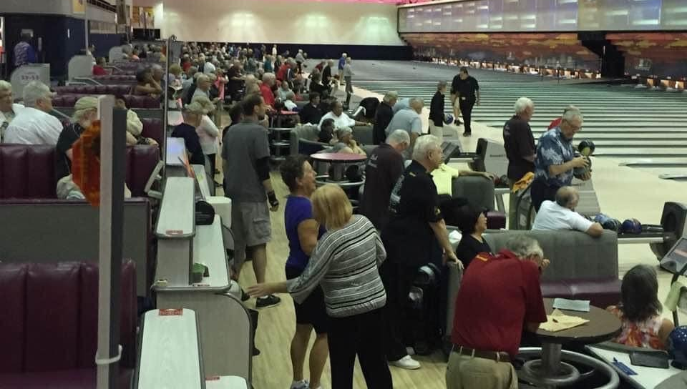
Join
In the
Fun
    • Come and share a meal
    • Join an activity
    • Forge friendships
    • Embrace life
    We invite you to join SIR.
    You can never have too many friends.
Notes:
FYI: Photo is of SIR participating in a bowling championship in Reno, NV.

Slide 15
Branch Information
  (Insert Branch luncheon or another event)
  (Date and time)
  (Rsvp info)
  To join other activities
  (Call/email or visit instructions here) (Visit Instructions?)
  To ask about other Branches go
  to WeAreSIR.com.
Notes:
How do you join SIR? I represent xxx Branch. I have a flyer here for you with information and an application. I’m happy to answer your questions.

Slide 16
Questions?

