Slide 1
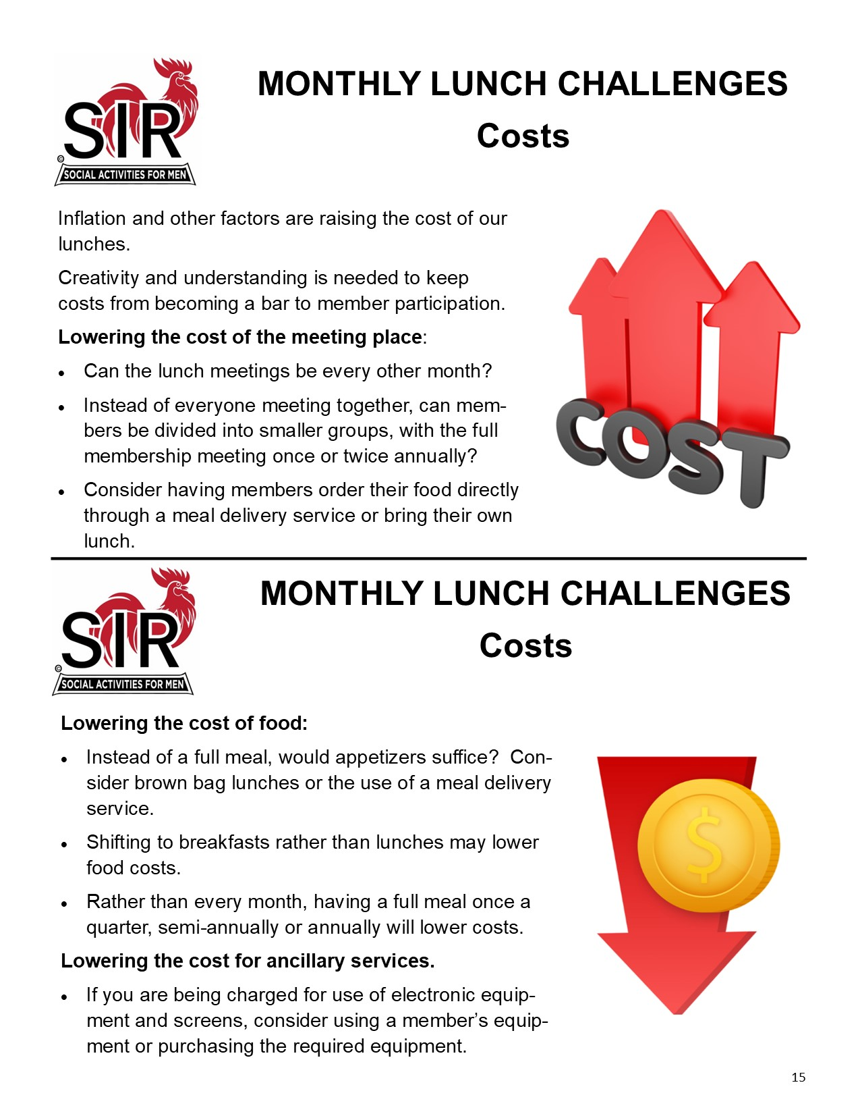
Recipe Cards
For Branch Success
Prepared by the
State SIR Growth and Membership Committee

Slide 32
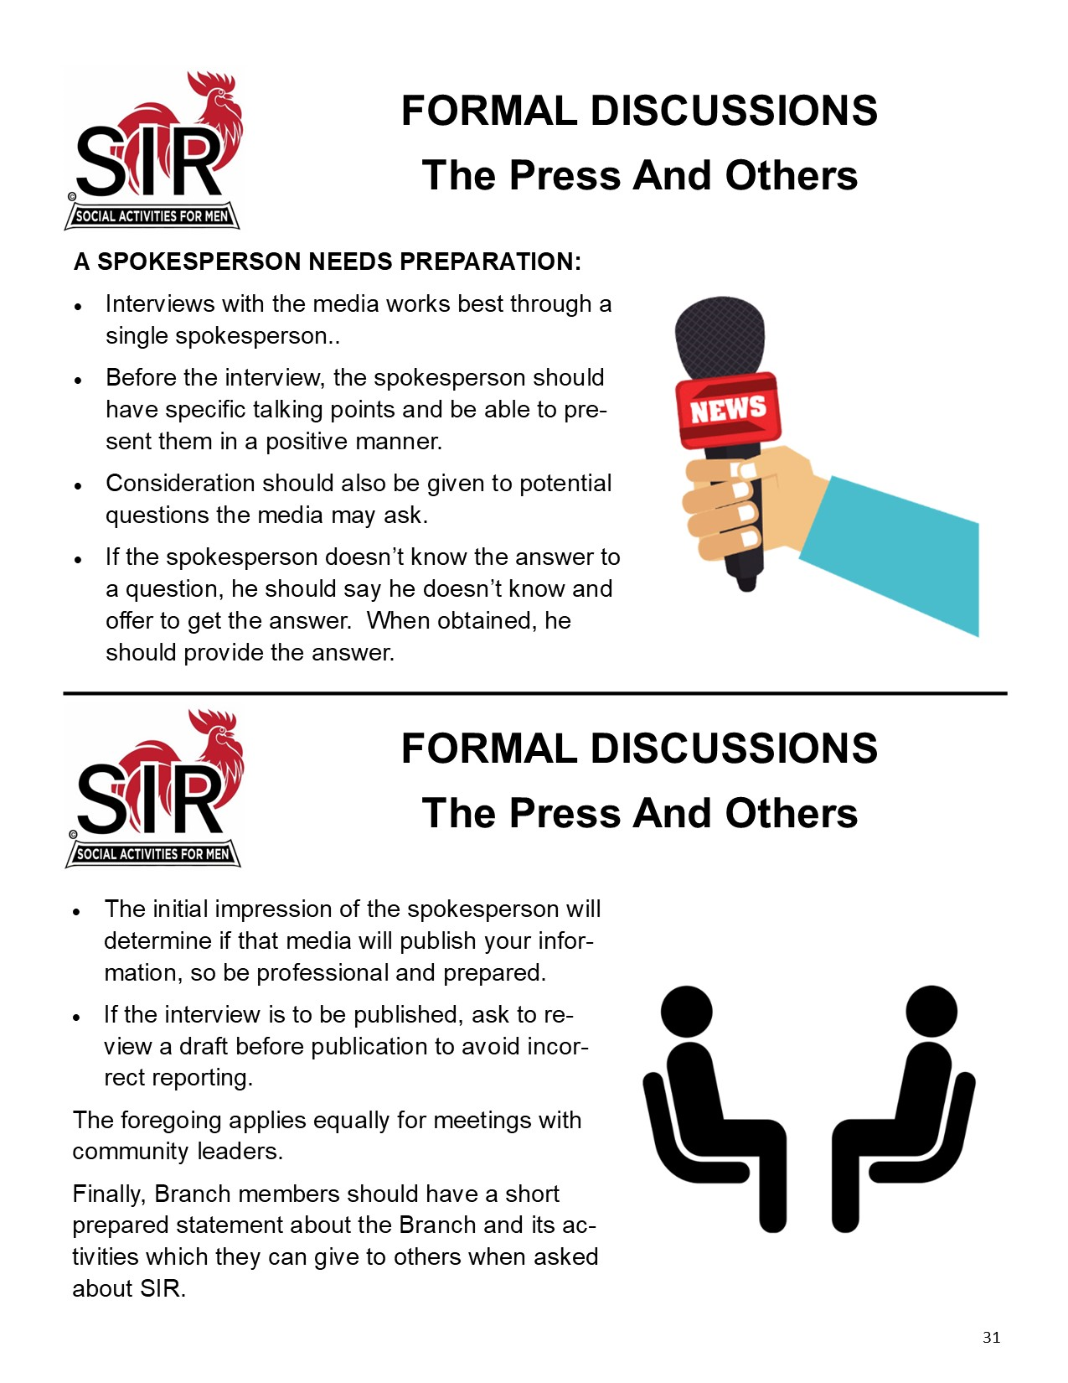

Slide 42
