Slide 1
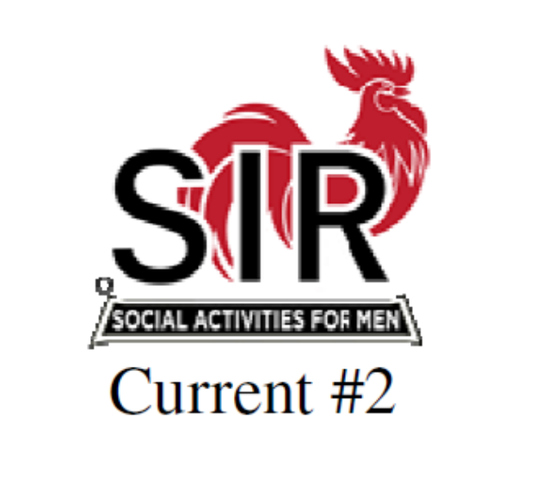
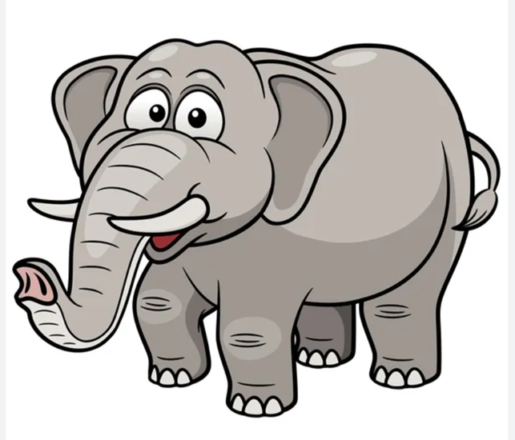
All Hands on Deck Meeting
Wednesday June 26th
Zoom at 2pm

Slide 2
So Where is SIR Going?
Notes:
We are at a crossroads! I’m going to share some facts regarding the overall health of the organization while at the same time letting you know that the members of the state board of directors has been meeting, reviewing options, debating, seeking outside input, and in general do everything we are REQUIRED to do in order to safeguard the organizations future. And without being too dramatic, that future is not well assured by any stretch of the imagination.
However, I want to make sure that in the spirit of transparency I want everyone to know this is the time to speak up. We are making everyone aware of what state believes is the best course of action to take but you do have a voice.
I also want to share that as an officer of the State Board I am obligated to present these facts and options based on the collective agreement of the board. It’s no different than when holding a position as Big Sir for my branch I was (and am) obligated to represent the positions of my collective branch. While I certainly have personal opinions and they have been expressed in meetings and debates, I stand before you today united with the rest of the state board in our strategy for moving into the future of SIR. I’m asking each of the Big Sirs on this call, acting as a member of the parent corporation to feel comfortable sharing your views and the views of your branches, but also understand that there is a balance that must be factored and weighed with respect to our future.

Slide 3
So how do you look at SIR ?
Every branch is different reflecting its community and current leadership.
Every Area is different reflecting its branches’ personality and geographical dispersion.
So can we agree on what SIR is or ought to be?

Slide 4
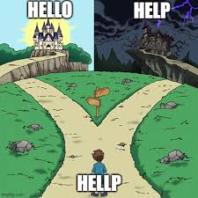
So how is SIR Really Doing ?
Invisible in our communities
Understaffed and underfunded to deliver State services
Tough attracting leadership at both the branch & State level
Membership is aging and declining at 4-7% per year
Branches are folding by merging or dissolving at 2-5 per year

Slide 5
Questions being asked at State SIR
Is SIR’s raison d’etre attractive to today’s individuals with leisure time
Are our incorporation documents reflective of the times
We are race and faith neutral – should we be age and gender neutral
Are our name and logo reflective of who we want and need to be
Are our position titles meaningful today or dated and funny
Who manages State SIR and its branches when no one volunteers

Slide 6
More State Questions…
Are we too “heavy handed” with unwanted “Rules and Regulations”
Is our business model (parent with many children) still viable
Are SIR’s “parent” services still wanted and needed by the “subsidiary”
For what services is a branch willing to pay State SIR to deliver
Should State SIR hire outside help to meet branch wants and needs

Slide 7
Questions Branches should be asking
How visible is our branch in our community – do we care?
What have we done lately to attract prospects – important to us?
What is more important to our members: lunches, activities, events?
How successful have we been attracting new BEC members?
Do we have a succession plan for all key positions in our branch?
For what do we look to State to provide – Anything?
What if State was to go away – where would we get their services?

Slide 8
A few of the details and issues:
SIR as an organization is at a Fork in the Road
36% of the branches are growing in membership - year to year
36% of the branches are slowly declining in membership
28% of the branches are rapidly declining in membership
Many Branches are “stand alone” organizations
Up to 40% don’t open State eMails or attend State functions
Most are unaware of State resources or content on State website
Attempts to follow State marketing guidelines or designs vary
Few have interest in collaborating with other branches
Many are slow to send in legally required documents
Most hold State SIR at “arms length”

Slide 9
The Road Not Taken By Robert Frost
This poem talks about having to make a decision when coming to a fork in the road – SIR is at the Fork
So what are SIR’s Alternatives ?
Keep on the same declining path with fewer branches and members.
Aggressively promote a new image to improve visibility & attractiveness.
Create a 501 (c) (3) organization, seek funding, hire leadership and promote SIR digitally and in local media to gain visibility and growth.

Slide 10
SIR’s “Breaking Glass” Actions #1
Easy to Do
Change the organization’s name and logo to better reflect our vision and purpose.
Change the local organization’s name from “Branches” to “Chapters”.
Change chapter officer titles from Big Sir to President and Little Sir to Vice President.
Promote the slogans "Enhance Your Lifestyle” and “Friends for Life” in our local communities to raise the chapter’s visibility and improve the % of the target audience (active adults with leisure time) to join a chapter.

Slide 11
SIR’s “Breaking Glass” Actions #2
Harder to Do
Make clear the right of “State” to set the strategic direction of the organization and enforce chapter Charters and By Laws including timely submission of government required information on Forms.
Make State’s websites more attractive and fix the bad chapter websites to positively promote the organization.
Attract new members who are enthusiastic about putting in the time and effort to lead their chapters.
Attract chapter leaders to participate in State leadership roles.

Slide 12
SIR’s “Breaking Glass” Actions #3
Needs More Research & Time Consuming
Change the corporation’s tax status from 501 (c) (4) “Social Welfare” to 501 (c) (3) “ Non-Profit Benefit” which makes donations tax deductible.
Update By Laws to reflect an organization which is race, religion, gender and age neutral.
Seek grants from California and foundations to fund projects to promote and grow the organization without impacting member assessments and branch dues.
Hire leadership for State, particularly an Executive Director, who will lead for more than one year given the leadership consistency and the leader authority.
Hire a professional full function digital marketing firm to attract individuals with more leisure time to apply with the leads forwarded to the chapters.
Outsource our Information Technology to adequately staff the function.

Slide 13
SIR’s “Breaking Glass” Must Do!!
All chapters must:
Use the current logo and slogan which means updating stuff.
Remember we have not been Sons In Retirement for 6 years.
Eliminate any age limits and the use of “retirement” in publications and when speaking about who can join a chapter.
Change Big/Little Sir immediately to President and Vice President …updated documentation to follow.
Stress the Activities and Events your chapter offers but avoid use of “social activities” rather stress “Enhancing Your Lifestyle”.
Help select and then agree on and use a new name and logo.

Slide 14
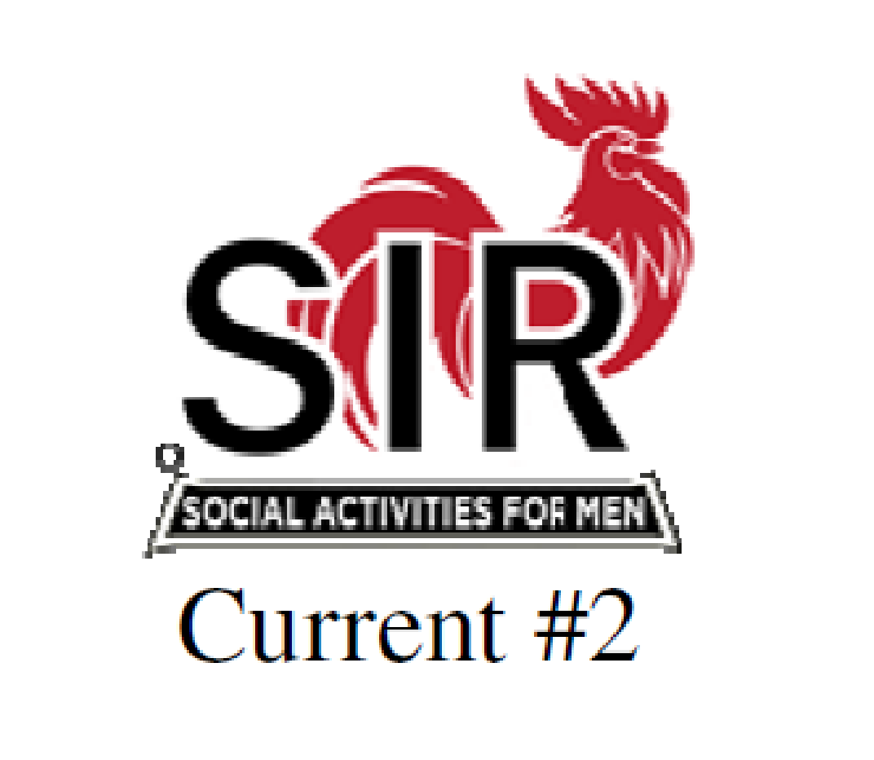
It’s time for a totally new Image ?
Create Our New Name - ?
Create Our New Logo - ?
Win a prize

Slide 15
Early Local Billboard Idea!
Notes:
Dale Decker created this model that can be used by any branch to create a single page poster that can be posted on community bulletin boards or store windows (just ask). I subscribe to the saying that “nothing beats a failure like an ask”….

Slide 16
Early Local Ad Idea!
Notes:
Rick Kindle created this for the branches in his area. The QR code take you to their individual branch websites. Find a way to embrace the available tech to expand your reach. It’s not hard. It’s a change. And we cannot be afraid of change. Frankly it is the only constant in the world today.

Slide 17
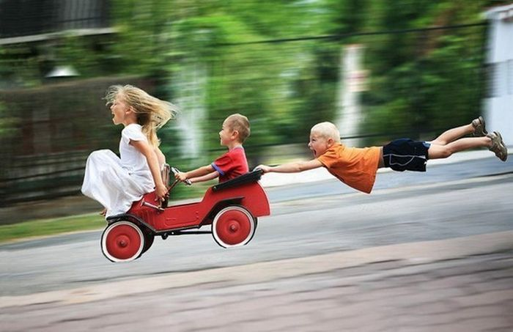
Q&A
Come Join the Fun!

Slide 18
The real details if you care ?
Membership has declined from 30,000 to 8,800 (Net 4%/yr.)
Operating costs including luncheon costs are inflating
Some branches have difficulty meeting restaurant minimums
Member median age is increasing at nearly a ½ year per year
An increasing number of members are “aging out”
New younger members are not replacing those aging out
Volunteering is declining as median age increases
Branches and State are having difficulty replacing leaders
Branches cannot or are not surviving without leadership
Branches have dropped from 179 to 84 for lack of leadership
Men with increasing leisure time appear not to be joiners

